Slide 1








Slide 3







WELCOME
to DIRECTORS!
Welkom!
Dobro došli!

Slide 4
Data in Our Hands
(and Mobile Devices)

Slide 5
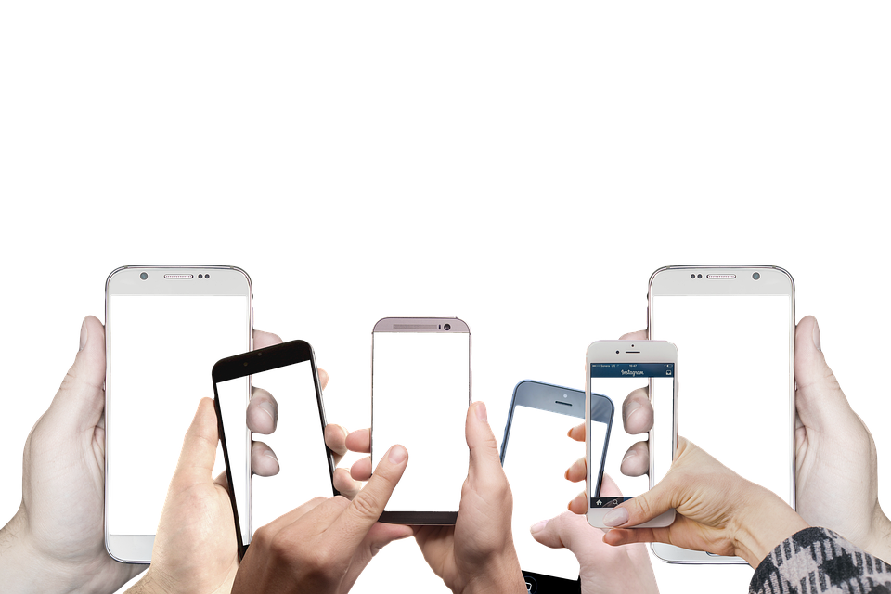
Mobile Device Usage Data

Slide 6
Did you know...
… that every day you're holding a lot of data in your hands?
… and that you can do all sorts of interesting things
with that data?
Hey, what is “data” anyway?
Never heard of that before…

Slide 7


Hands up!
Cats?
Dogs?

Slide 8

Pets?
Besides cats and dogs?
What do we know about your pets?
How can we find out more?

Slide 9
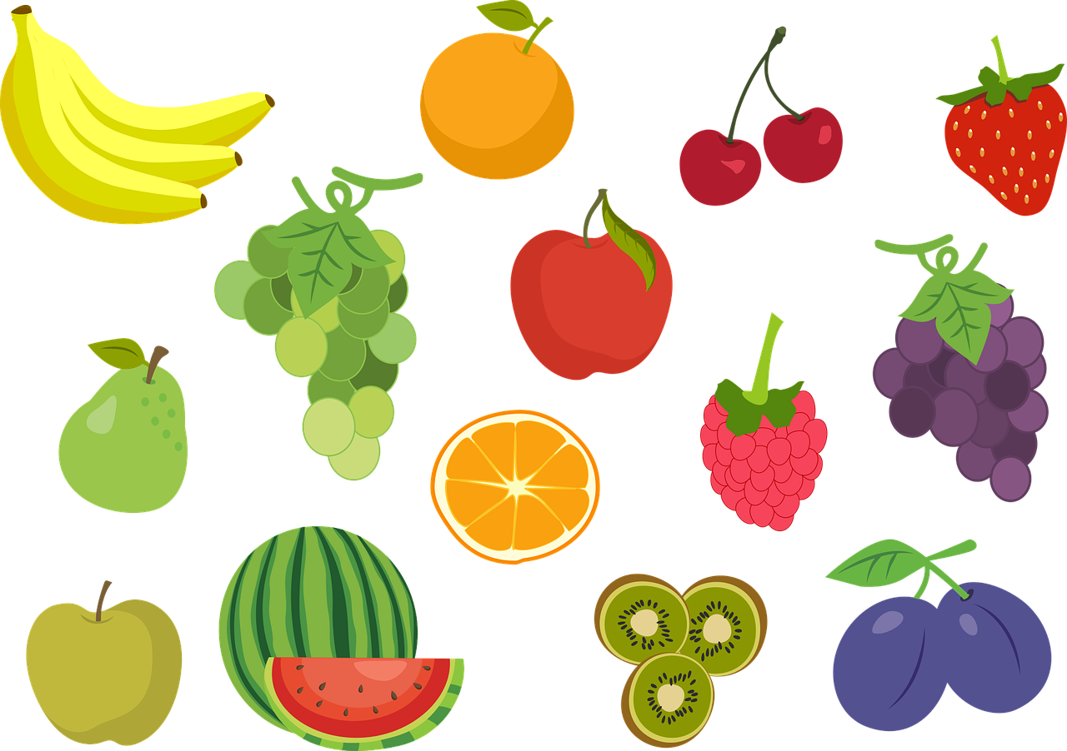


Let’s get back to „data”...
Ever heard of „data”? What would that be?
Supermarket? Sports results? School grades?

Slide 10

Data ...
How is data created?
Can we make it ourselves?
Can we collect it ourselves?

Slide 11
Today, we will...
Get to know different types of data in the real world
Group data to discover interesting things
See that data can be similar or different
Learn how to use data to find answers
to your own questions

Slide 12
Mobile phones ...

Slide 13

Hands up!
Who owns a mobile phone?
Who sometimes uses their parents’ mobile phones?

Slide 14
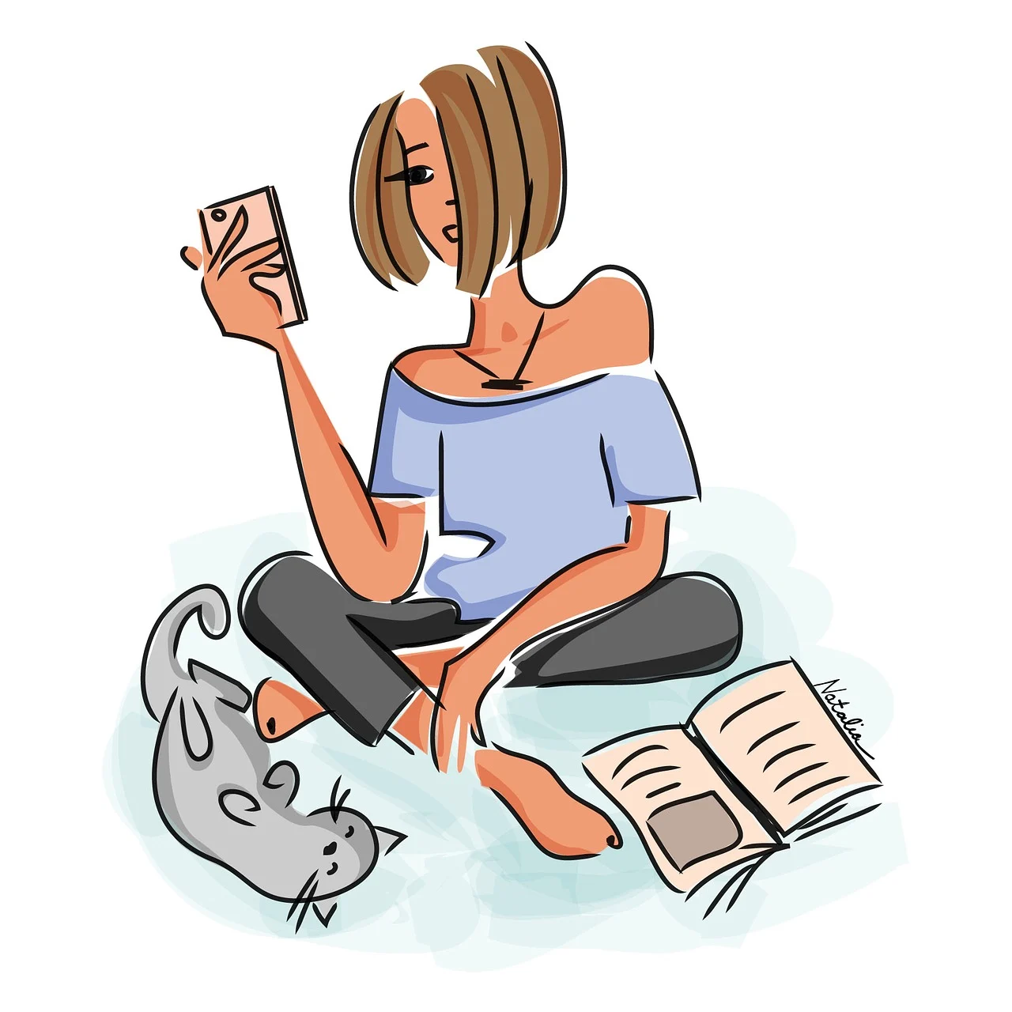
Mobile phones ...
Do you use it every day?
How?

Slide 15
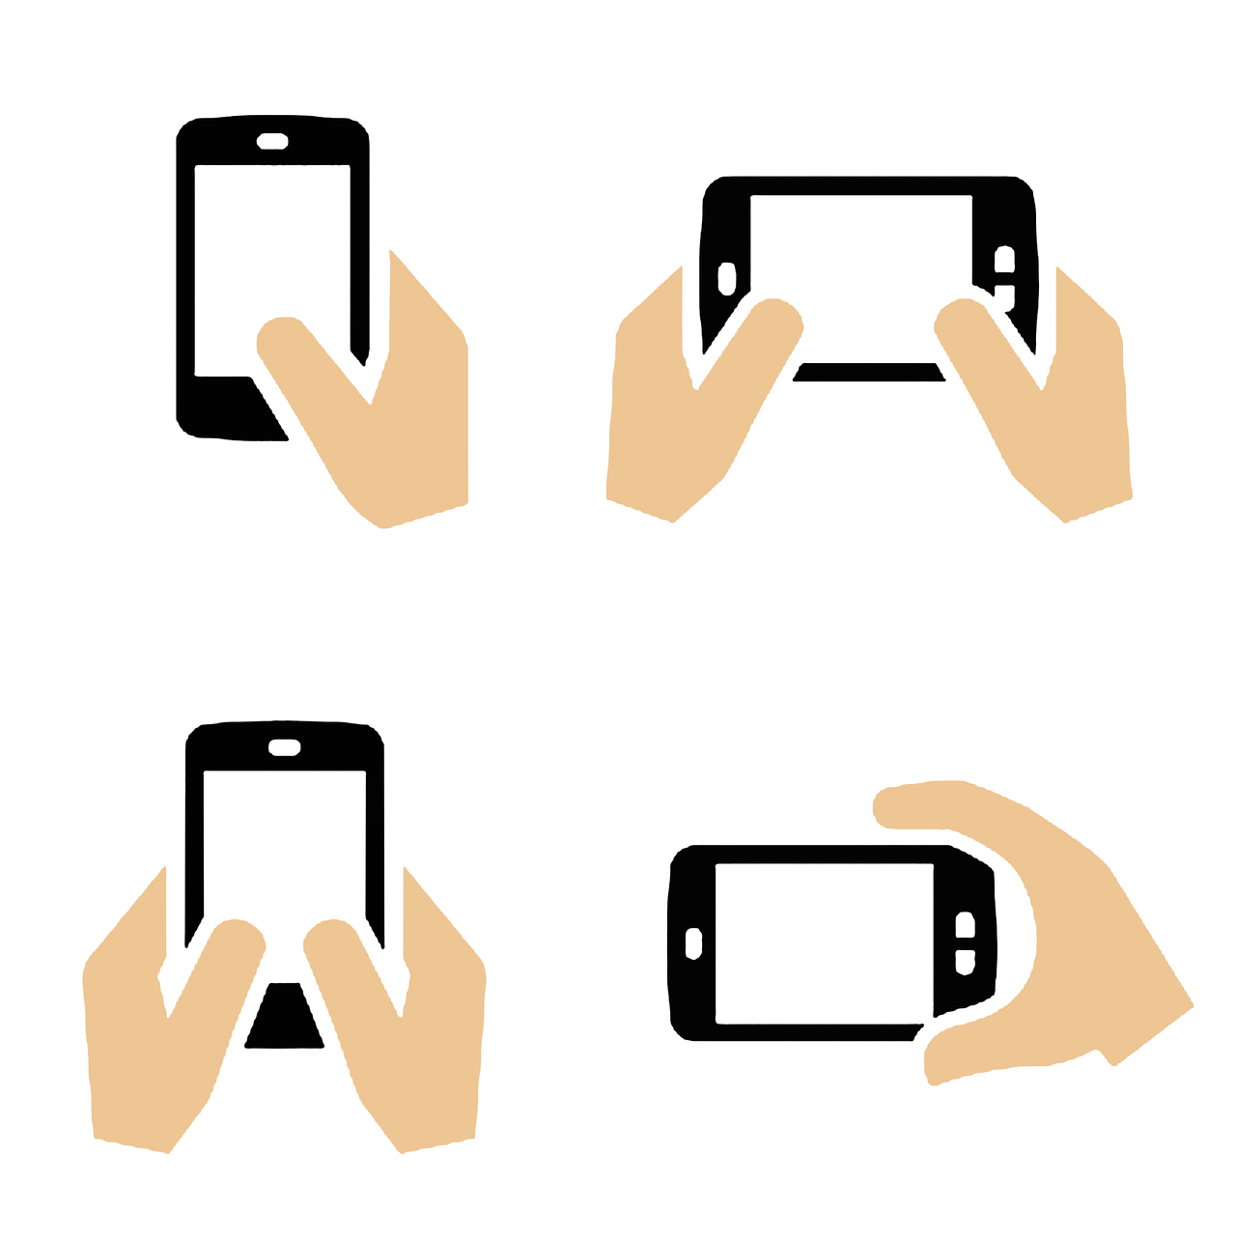
Can you estimate…
How many different apps did you use yesterday?
How long (in minutes) did you use your phone yesterday?
Do you sometimes use your phone
while doing something else?
  Do you listen to music on your phone?

Slide 16
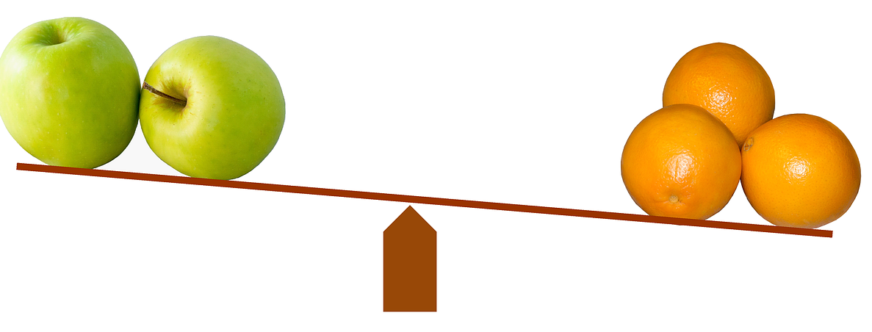
What do you think…
Do you use the same apps as your friends?
Do you use your phone more or less than your friends?
Do you use your phone more or less than your parents?

Slide 17

What is your…
Favourite game?
Favourite video channel?
Favourite chat app?

Slide 18

Do you know…
What are the most popular games, video channels, chat apps?

Slide 19
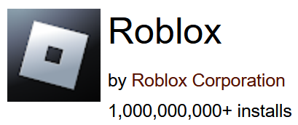
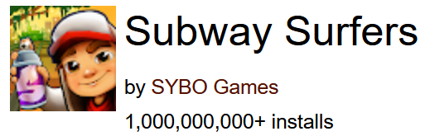
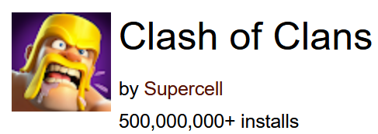
The most popular games…
Adventure:
Arcade:
Strategy:
Source: https://www.androidrank.org/

Slide 20
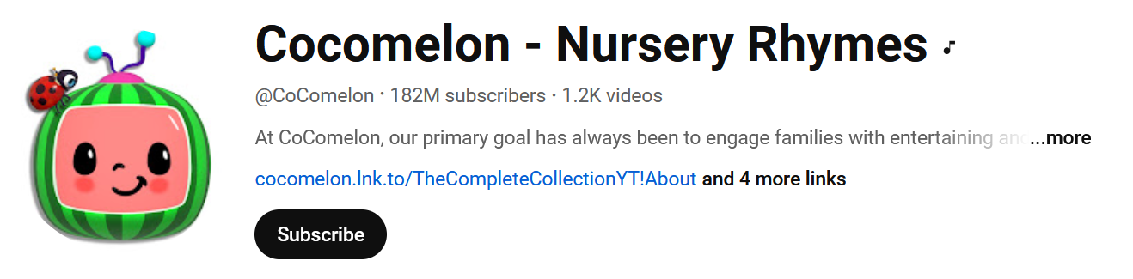
The most popular YouTube channel for kids

Slide 21
Let’s get the data…

Slide 22
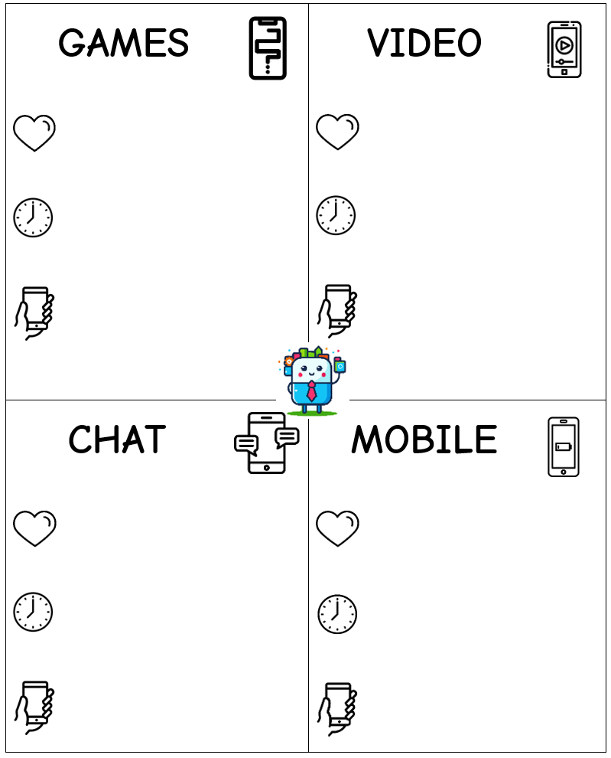
Data cards...
Everyone, take one card.
Write your name on the back.
Let’s fill in the data!
Describe how you use your phone!

Slide 23
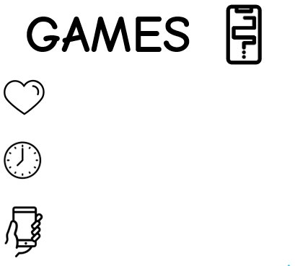
How to fill the card?
What is your favourite game?
How many minutes per day do you play games?
How many times per day do you pick up your device to play games?

Slide 24

How to fill the card?
What is your favourite channel?
How many minutes per day do you watch the videos?
How many times per day do you pick up your device to watch the videos?

Slide 25

How to fill the card?
What is your favourite chat app?
How many minutes per day do you chat?
How many times per day do you pick up your device to check for chat updates?

Slide 26

How to fill the card?
What is your favorite app that is not a game, YouTube or a chat app? ​
How many minutes per day do you use your device?
How many times per day do you pick up your device?

Slide 27
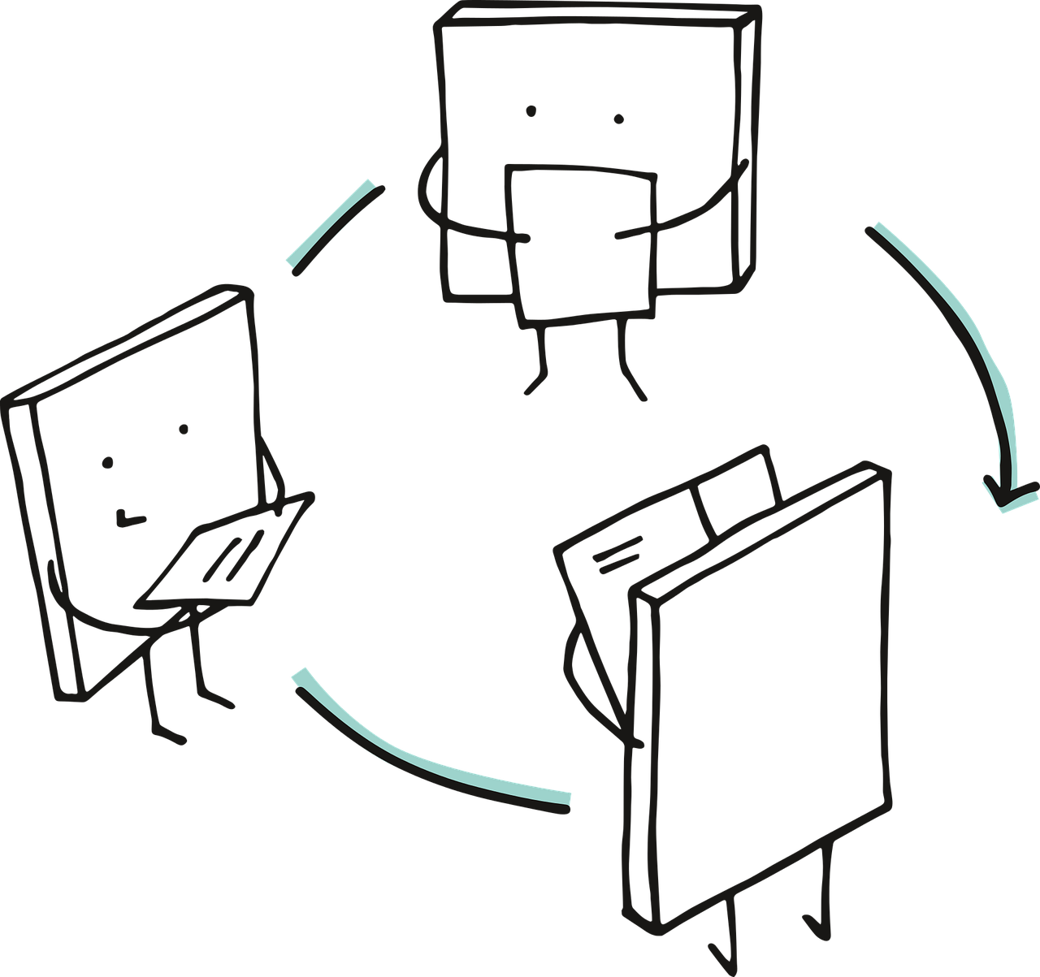
Time to „get up”!
Take your card and group by the favourite game
Go to the room corners!

Slide 28
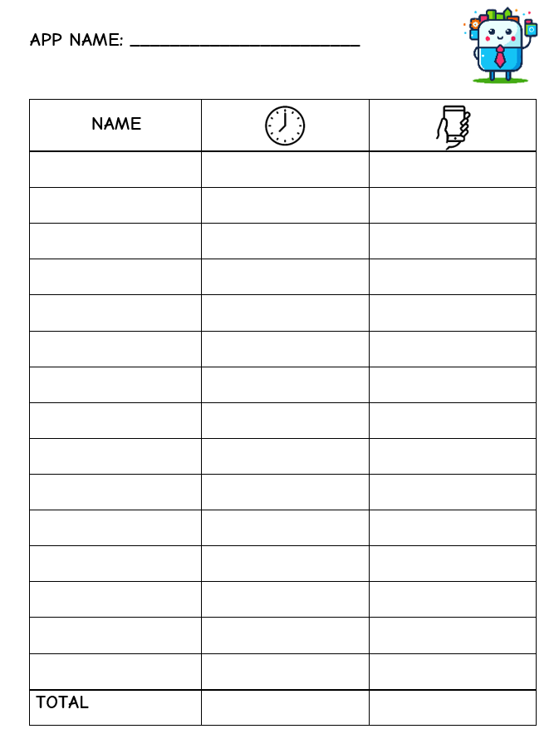

In your corner…
Compare your cards!
  How are they similar?
  How are they different?
Fill out this paper:

Slide 29
Let’s talk about our data

Slide 30


Ever heard of „word cloud”?

Slide 31
What can we see in a word cloud?

Slide 32

Did you write the app names correctly?

Slide 33
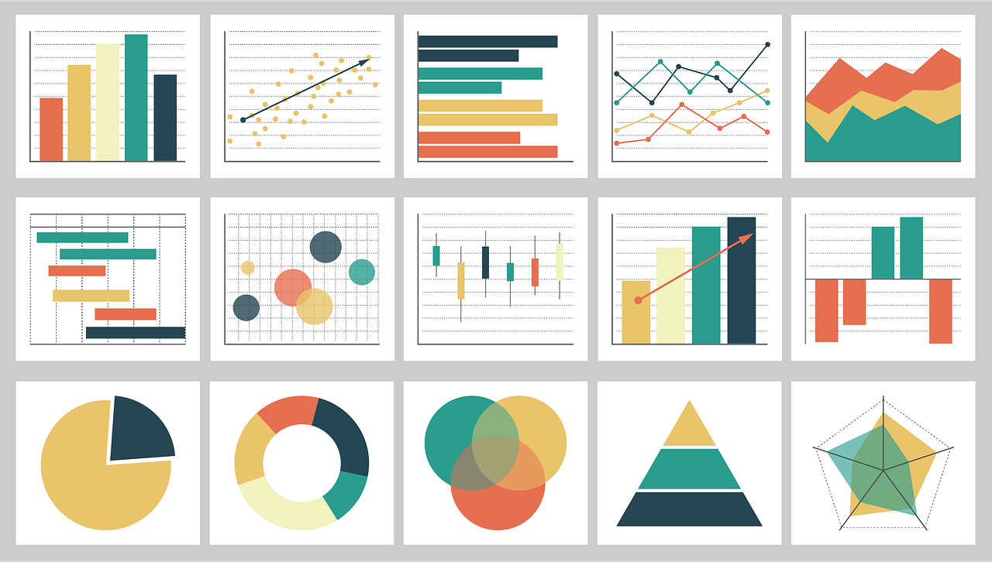
Are there better ways to show data?

Slide 34

Before the next time…

Slide 35

So… How was it today?

Slide 36
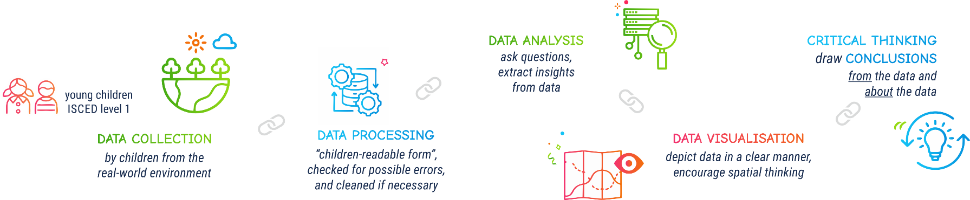

Slide 37







Contact information:
DIRECTORSproject
Assoc. Prof. Ivana Bosnić
ivana.bosnic@fer.unizg.hr
University of Zagreb
Faculty of Electrical Engineering and Computing
Assist. Prof. Ana Kuveždić Divjak
ana.kuvezdic.divjak@geof.unizg.hr
University of Zagreb
Faculty of Geodesy
Universitair Hoofddocent
Bastiaan van Loenen
B.vanLoenen@tudelft.nl
Delft University of Technology
info@kidsdirectors.eu
www.kidsdirectors.eu
Co-funded by the European Union. Views and opinions expressed are however those of the author(s) only and
do not necessarily reflect those of the European Union or the European Education and Culture Executive Agency (EACEA). Neither the European Union nor EACEA can be held responsible for them.
[Erasmus+ Project 2023-1-NL01-KA210-SCH-000157821 DIgital data-dRiven EduCaTion fOR kidS]

