Slide 1








Slide 3







WELCOME
to DIRECTORS!
Welkom!
Dobro došli!

Slide 4
Data in Our Hands (and Mobile Devices)

Slide 5
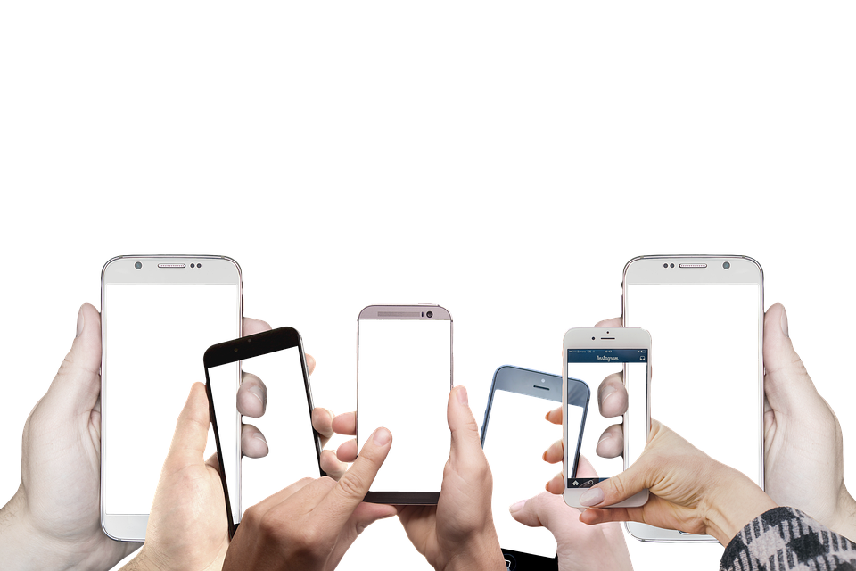
Collecting and Analysing Mobile Device Usage Data

Slide 6
Did you know...
„See through data”? How do I do that? What can I see?
That your mobile phone collects a lot of data?
That you can see through that data and make sense out of it?
That there is a difference between guessing and real data?

Slide 7

Do you remember what we did last time?

Slide 8

Hands up!
Homework - table?
Mobile phone in the classroom?

Slide 9
Today we will...
Learn which data our mobile phone collects
Enter our data and show it as a picture – visualise them
Compare our data with other classmates and estimations from last time
Use the visualisations to answer some questions
See that the way we enter our data makes a big difference

Slide 10
What data could a mobile phone create?
1 …
3
4
5
6
7
8
9
2
10
11
Let’s write them down together!
Is this data...
A number?
A word or a few words?
A choice for us to pick from the list?
...

Slide 11
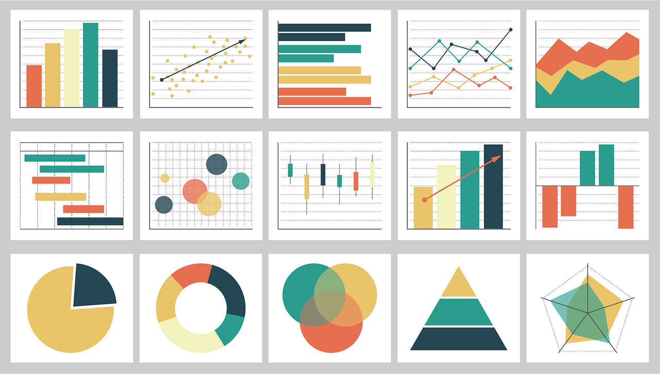
Did you know...
… that you can convert data to pictures or even movies
We call this data visualisation

Slide 12
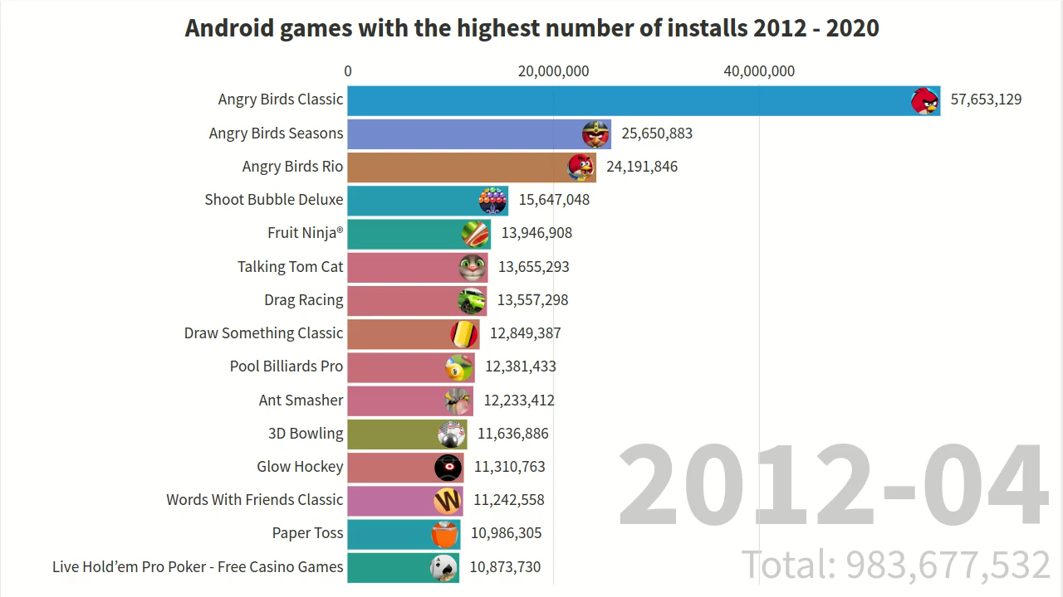
The most popular games over the years…
https://youtu.be/gYucHINoDnI

Slide 13
„Check your device” time!

Slide 14
Finally – real data!

Slide 15

„Homework” paper
If you didn’t bring it, sit with a friend

Slide 16
Did you bring a device? No?
Take your homework sheet
Sit with a friend who has brought one

Slide 17

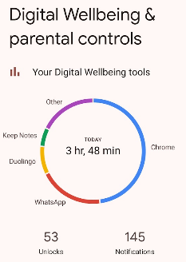
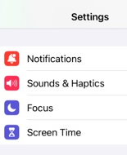
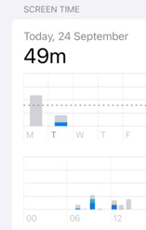
So, where to find our data?
Android phone
iPhone

Slide 18
What can you find in the app?
Take your data card from last time
Can you find all the data you guessed last time?
Is there anything else you’d like to know about your phone usage?

Slide 19

Compare your predictions to actual data
How correct were you?

Slide 20

„Input your data” time!

Slide 21

We’ll gather all our data in one place
Open the web-browser
Enter this address…
//LINK TO THE ONLINE FORM//

Slide 22
„Make sense of data” time

Slide 23

This is our data...
All data in one place, finally!
How is this different from data cards?
How is this different from word clouds?
Is our data – messy? What went wrong? What can we do?
Can we see something more than just tables and numbers?

Slide 24

Can we group our data?
Games?
Videos?
Chat apps?

Slide 25

How can we see through all this data?
Ever heard of – graphs?

Slide 26

What can we find out from graphs?

Slide 27
Thinking about...
Why were there differences between your guesses and actual data?
Which was better: raw data in a table, or visualized graphs?
What did we find out?
Did we expect the results?
What about wrongly entered data?
Do you know who is who in the table?
Why is „anonymization” important?

Slide 28

What you could do next...
Compare your data
to your parents at home
to your other friends

Slide 29

So… How was it today?

Slide 30
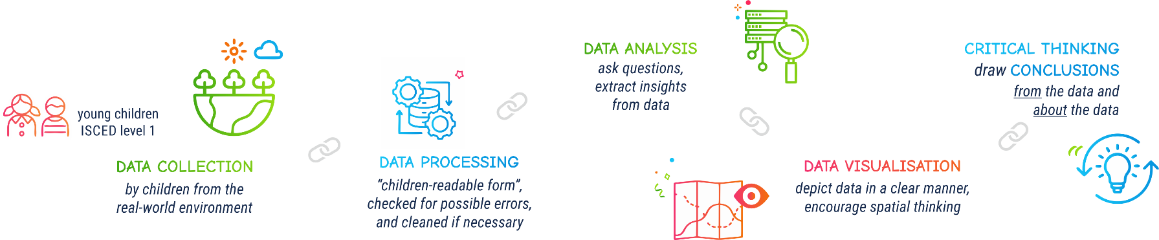

Slide 31







Contact information:
DIRECTORSproject
Assoc. Prof. Ivana Bosnić
ivana.bosnic@fer.unizg.hr
University of Zagreb Faculty of Electrical Engineering and Computing
Assist. Prof. Ana Kuveždić Divjak
ana.kuvezdic.divjak@geof.unizg.hr
University of Zagreb Faculty of Geodesy
Universitair Hoofddocent
Bastiaan van Loenen
B.vanLoenen@tudelft.nl
Delft University of Technology
info@kidsdirectors.eu
www.kidsdirectors.eu
Co-funded by the European Union. Views and opinions expressed are however those of the author(s) only and do not necessarily reflect those of the European Union or the European Education and Culture Executive Agency (EACEA). Neither the European Union nor EACEA can be held responsible for them. [Erasmus+ Project 2023-1-NL01-KA210-SCH-000157821 DIgital data-dRiven EduCaTion fOR kidS]

