Slide 1








Slide 3







WELCOME
to DIRECTORS!
Welkom!
Dobro došli!

Slide 4

Data Sources

Slide 5

From our Bodies to Sensor Technologies

Slide 6

Hands up!
Who lives the closest to the school? Do you live far away?
How do you come to school? By foot, by bike, by bus?
How many steps did you already make today?
  How do you know it?
  Why would it be important to know that?

Slide 7
Did you know...
„Data”?
What is „data”?
That your mobile phone collects a lot of data?
That your mobile phone can help you with your health?
That the sports tracker on your hand collects a lot of data?
That the sports tracker can help you with your health?

Slide 8
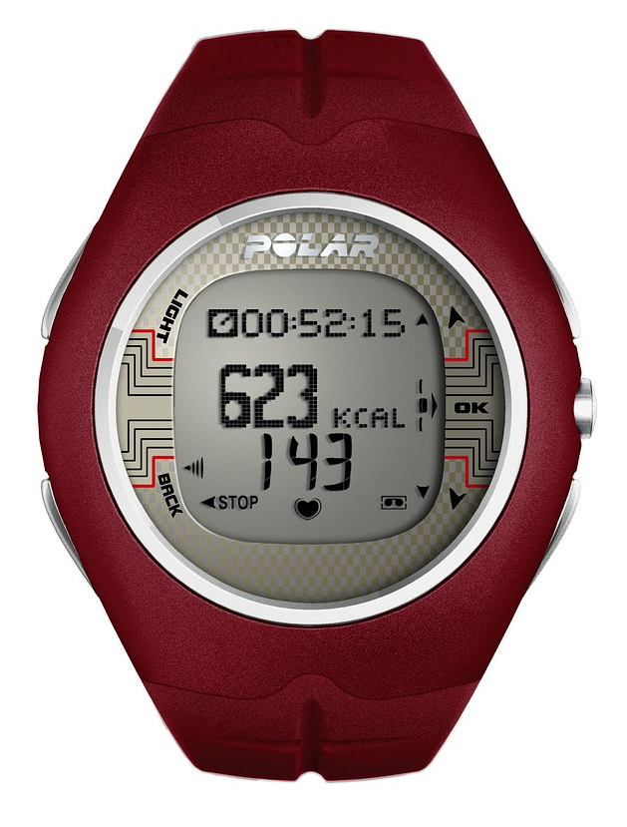
Hands up!
Mobile phone in the classroom?
Sports tracker on your hand?
Any idea what a „sports tracker” on your hand can do?
Any idea what a mobile phone can do in sports and health?

Slide 9

Did you know ...
That your step length (stride) is closely related to your height?
That your step length is closely related to your running speed?
That before new technology (GPS), cyclists would calculate their trip lengths by having a small magnet count the number of wheel rotations?

Slide 10
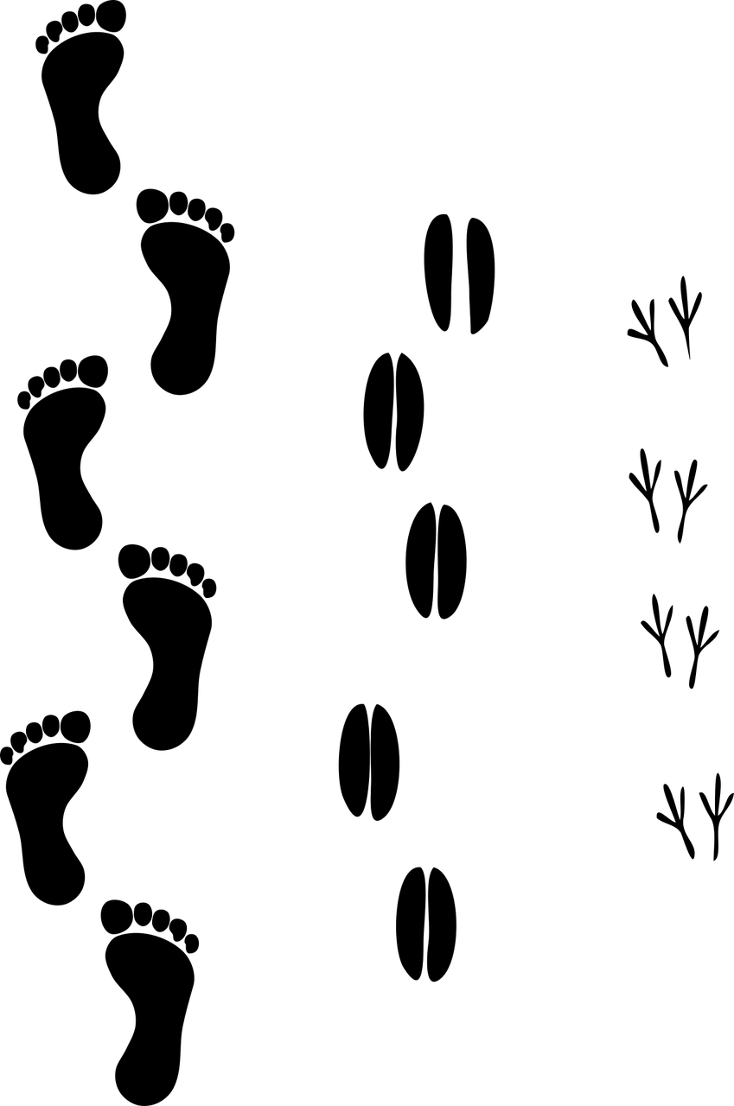
What do you think ...
How many steps you need to take from one side of the classroom to the other?
  Take a sticky note and write down your guess!
  Write down your name as well
How many steps you need to take from ... to ... ?
  Will you always make the same number of steps?
  Will two friends walking together make the same
  number of steps?

Slide 11

What do you think ...
Is there an exact number of steps you did today?
How can we measure that?
  Will those methods always give us the same answers?
Is there an exact distance between two objects?
How can we measure that?
  Will those methods always give us the same answers?

Slide 12
Today we will ...
Learn that there are different ways to obtain data for the same goal
See that we can do things manually or with technology
Compare the different methods to get the data
Learn how to choose the best way for calculating distances

Slide 13

Counting the steps - manually

Slide 14
Count the steps from point A to point B
Walk normally
  If the last step is very small, don’t count it
  If the last step is almost a full one, count it
Don’t cheat!

Slide 15
Count the steps from point A to point B
Write your number of steps on a sticky note
which you already have
Compare two numbers – your guess and your measurement!
Is it hard to count steps manually?
Did you all get the same results?
If you did the walk twice, did you get the same results?

Slide 16
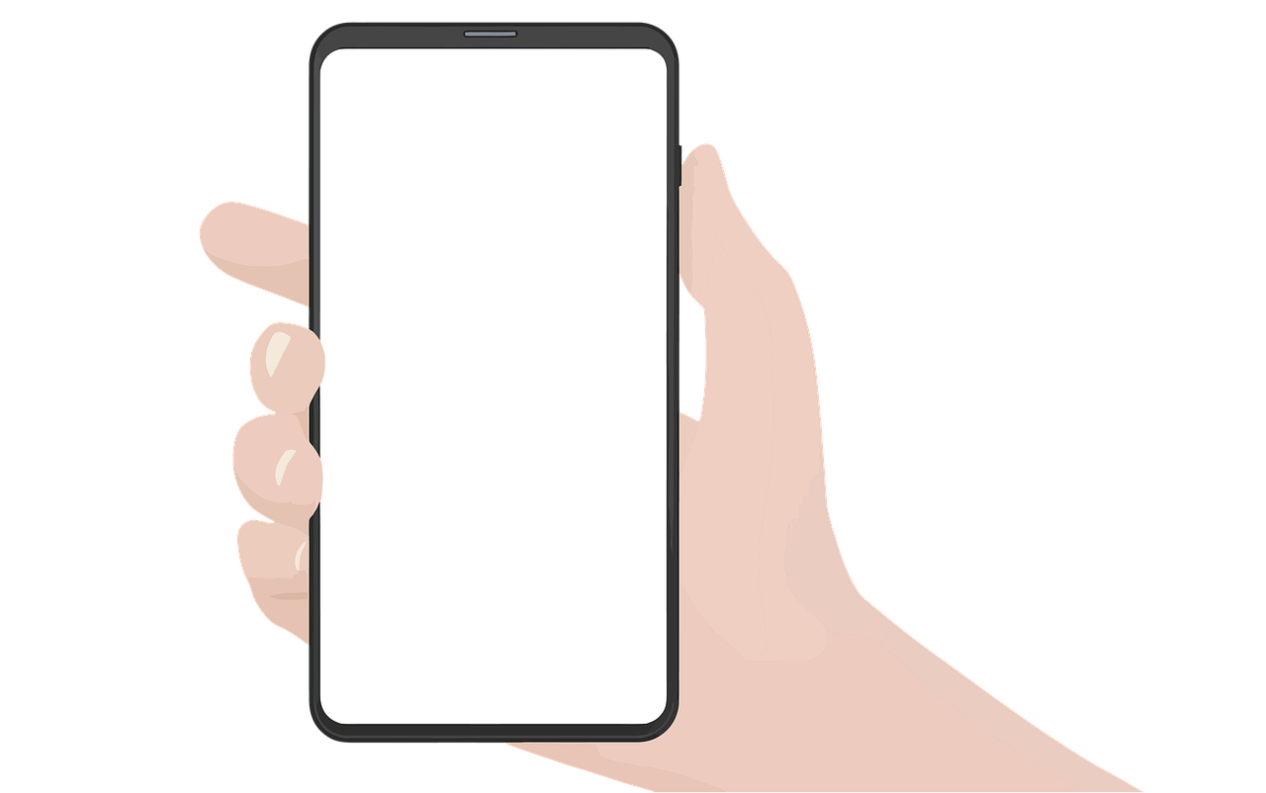
Counting the steps - mobile phone

Slide 17
Hands up!
„Sensors”?
I don’t understand that word...
Ever heard of the word „sensors”?
Sensors – „sense”!
Any idea what can sensors „sense”?
Which sensors exist in a mobile phone?

Slide 18
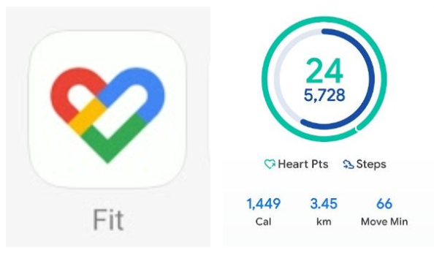
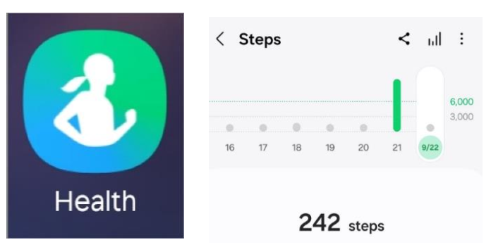
Pedometer apps in a mobile phone
Already enabled

Slide 19
Count the steps from point A to point B
Take your phone, open your pedometer app
Stand still at the point A! Wait 10 seconds
  Remember the starting number of steps
Start walking to the point B
  Walk normally, don’t look at the screen, have the phone in your hand
Count manually also!
Stop walking at the point B
Stand still at the point B! Wait 10 seconds
  Remember the ending number of steps
Subtract two numbers, write the result down on your sticky note

Slide 20
What do you think?
Were the results different from manual counting?
Is the measurement accurate if...
  ... You walk 1 step, or 10 steps
  ... You look at the screen while walking and keep your hand still
  ... You keep the phone in your pocket
  ... You leave the phone the table and walk around? ☺
Can you cheat with the mobile phone counting steps?

Slide 21

Counting the steps - sports tracker / smartwatch

Slide 22
Sports trackers / Smartwatches
Anyone has it?
Why do you wear it?
What will give more accurate results:
  manual count?
  mobile phone?
  sports tracker?
Why?

Slide 23
Count the steps from point A to point B
Put the sports tracker on your wrist
Stand still at the point A! Wait 10 seconds
  Remember the starting number of steps
Start walking to the point B
  Walk normally, don’t look at the screen
Count manually also!
Stop walking at the point B
Stand still at the point B! Wait 10 seconds
  Remember the ending number of steps
Subtract two numbers, write the result down on your sticky note

Slide 24
What do you think?
Which method is the least convenient?
Which methods should be the most precise?
Does it matter if you’ve made a short or a long walk?
Could you cheat a smartwatch?

Slide 25
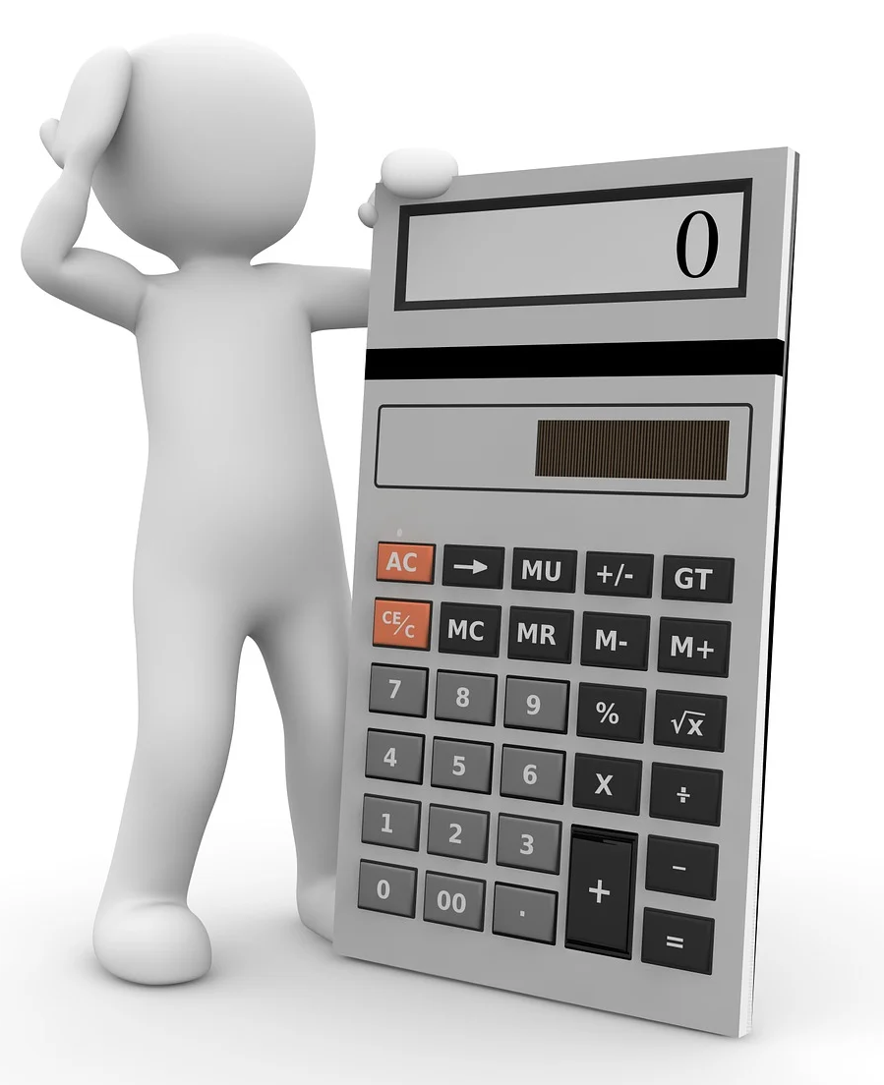
From steps to distances

Slide 26
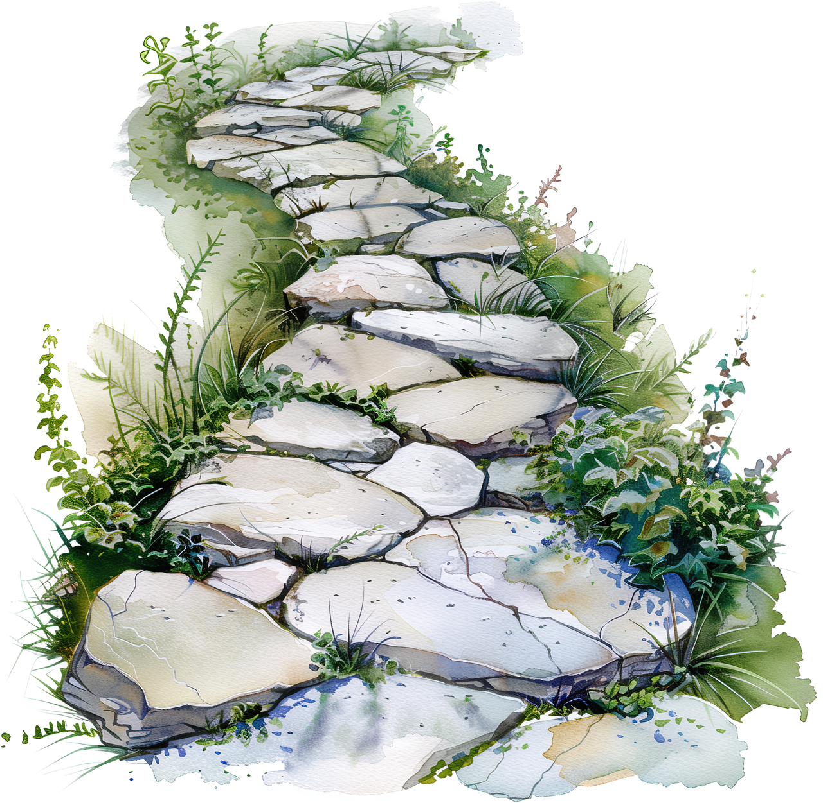
Measuring vs Calculating
What did we measure now?
Did we measure distances?
Can we calculate distances from steps?
  What do we need for that?
Do mobile phones and sport trackers
also show the distances?
  How do they know it?

Slide 27

Let’s calculate some distances
From steps ...
  Calculate the step legnth
  from 10 steps
From height ...
  Calculating step length
  from height:
    men: height * 0,415
    women: height * 0,413

Slide 28

What do you think about this?

Slide 29

So... How was it today?

Slide 30
Homework! ☺
Do you WALK to school?
Do you BIKE to school and have a mobile phone?
Do you come to school by CAR or by BUS?

Slide 31
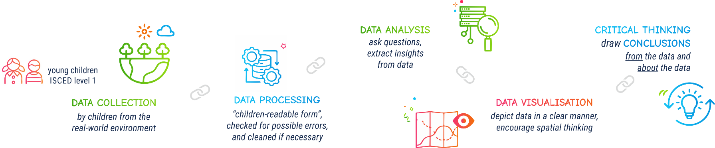

Slide 32







Contact information:
DIRECTORSproject
Assoc. Prof. Ivana Bosnić
ivana.bosnic@fer.unizg.hr
University of Zagreb
Faculty of Electrical Engineering and Computing
Assist. Prof. Ana Kuveždić Divjak
ana.kuvezdic.divjak@geof.unizg.hr
University of Zagreb
Faculty of Geodesy
Universitair Hoofddocent
Bastiaan van Loenen
B.vanLoenen@tudelft.nl
Delft University of Technology
info@kidsdirectors.eu
www.kidsdirectors.eu
Co-funded by the European Union. Views and opinions expressed are however those of the author(s) only and
do not necessarily reflect those of the European Union or the European Education and Culture Executive Agency (EACEA). Neither the European Union nor EACEA can be held responsible for them.
[Erasmus+ Project 2023-1-NL01-KA210-SCH-000157821 DIgital data-dRiven EduCaTion fOR kidS]

