Slide 1








Slide 3







WELCOME
to DIRECTORS!
Welkom!
Dobro došli!

Slide 4

Data Sources

Slide 5

Technology to the Rescue!
Or not?

Slide 6

Do you remember what we did last time?

Slide 7
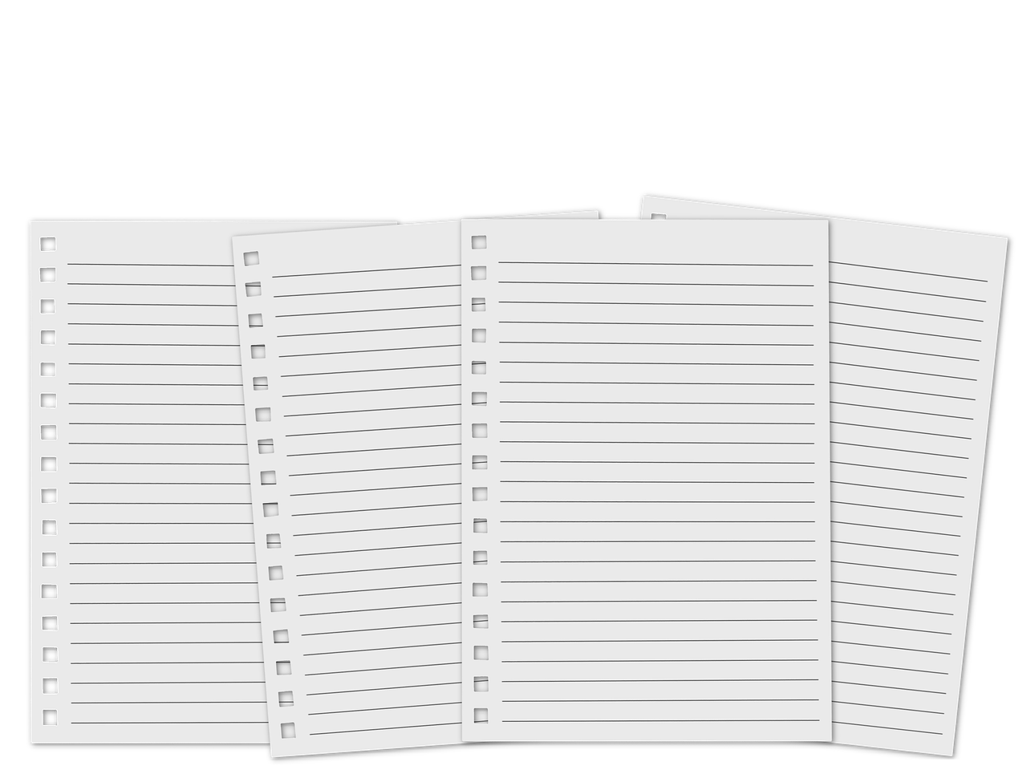
Did you have some homework?
What did you find out?

Slide 8
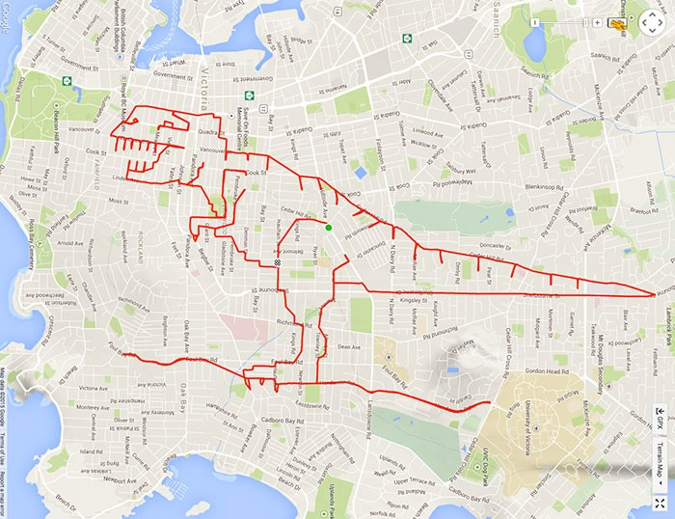
Did you know...
That you can make pictures by riding a bike?
https://www.boredpanda.com/bike-gps-doodle-stephen-lund/

Slide 9
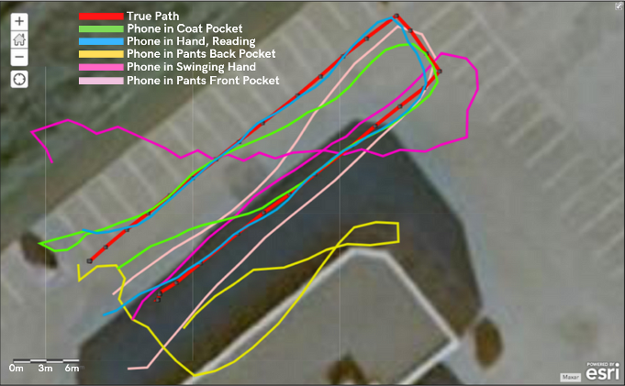
Did you know...
That we’re not the only ones testing these devices...
https://medium.com/@importanttech/we-tested-mobile-gps-gnss-accuracy-and-found-some-surprising-results-b9ec35873e2e

Slide 10
Today we will...
Use more technology to obtain data
See the differences in the results
Compare the differences and these methods
Choose the appropriate ways to measure distances

Slide 11

Online tools for measuring distances

Slide 12
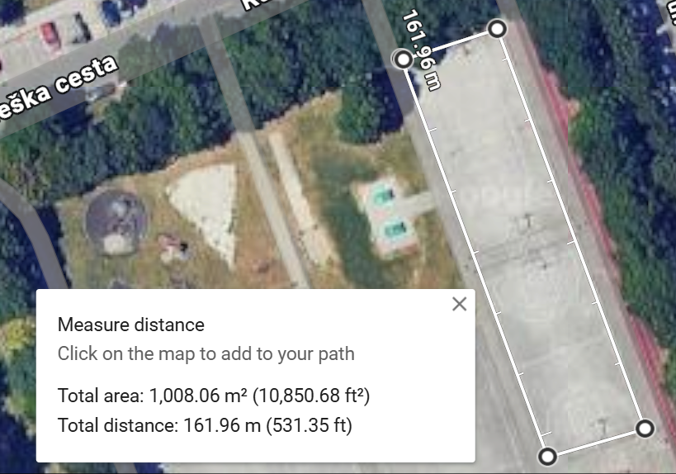

Ever heard of Google Maps?
Google can tell you the distance
between several points
On the computer:

Slide 13
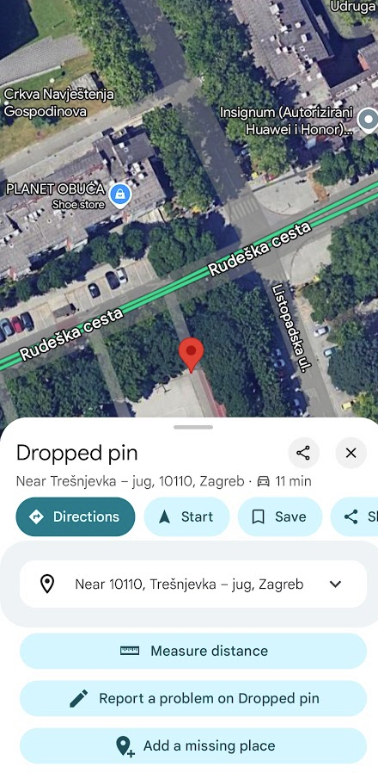
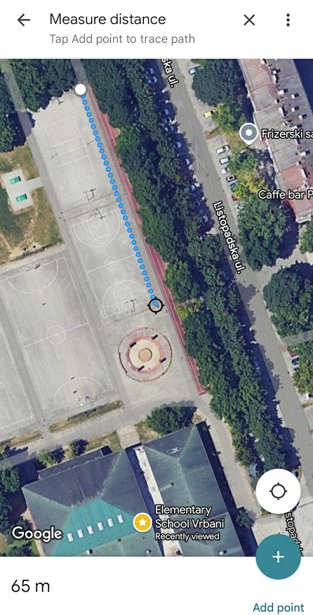
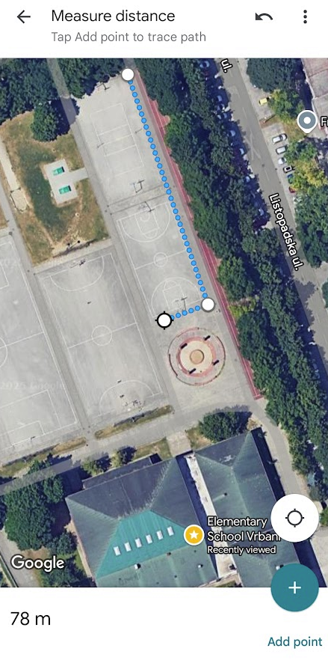
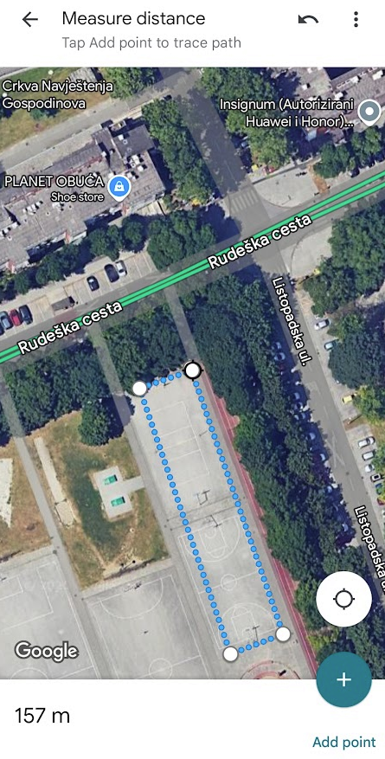
Ever heard of Google Maps?
Google can tell you the distance
between several points
On the mobile phone:

Slide 14
Using the
SATELLITES to help us

Slide 15
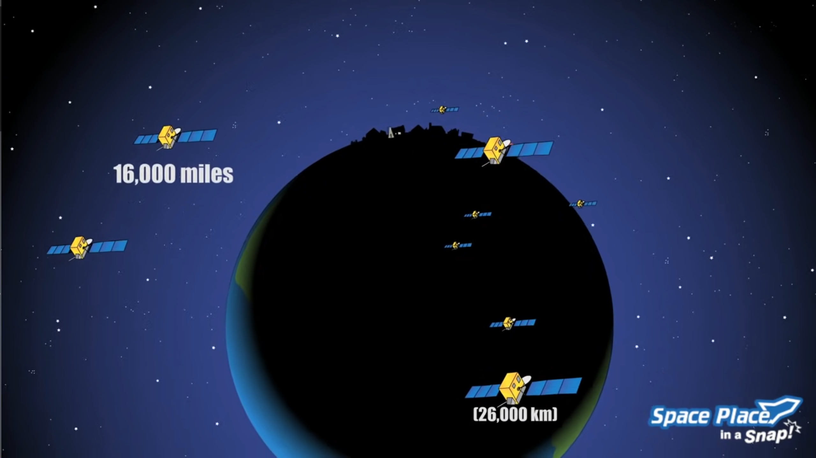
What are – satellites? What is – GPS?
How does
GPS work?

Slide 16
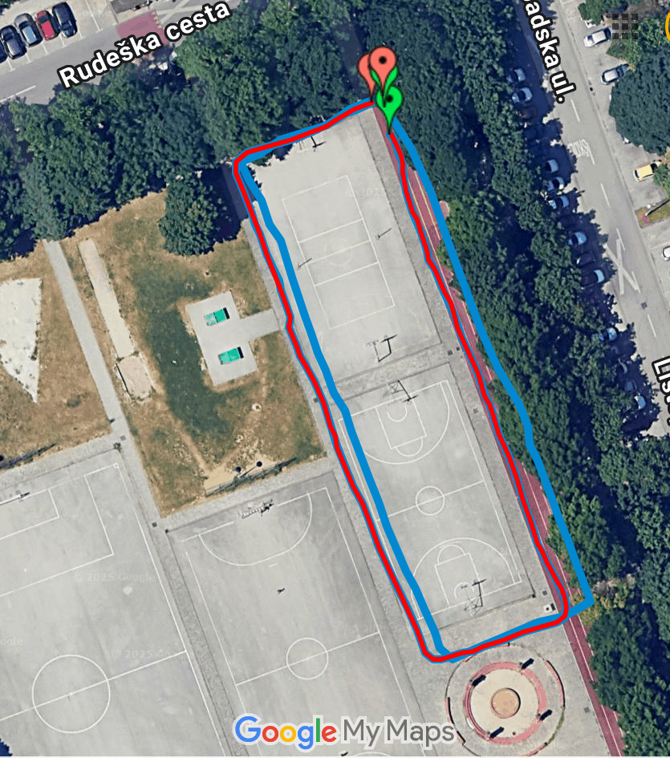
With satellites, we can...
Know „exactly” where we are
  To a few meters
  Depending on the weather,
  the buildings, ...
Record where we walk, run, bike...
  Using special apps
  Although with some „mistakes”
And then show it on the map
  To do more analysis

Slide 17

Let’s go and measure!

Slide 18
5 groups
Group 5: Who has a smart watch?
Group 4: Who has a mobile phone with Internet access?
Group 3: Who has a mobile phone without Internet access?
Pupils without a phone:
Group 2: Who wants to record a GPX track with our phones?
Group 1: Who just wants to walk and count the steps?

Slide 19

Let’s go out to experiment...

Slide 20
And let’s see what we’ve found out!
Results comparison?
Google My maps:
  https://mymaps.google.com/

Slide 21

What do you think about this?
Why were there the differences?
Which results are the most correct?
Can you trust the results?
Is it worth it? Is it important?

Slide 22

So... How was it today?

Slide 23
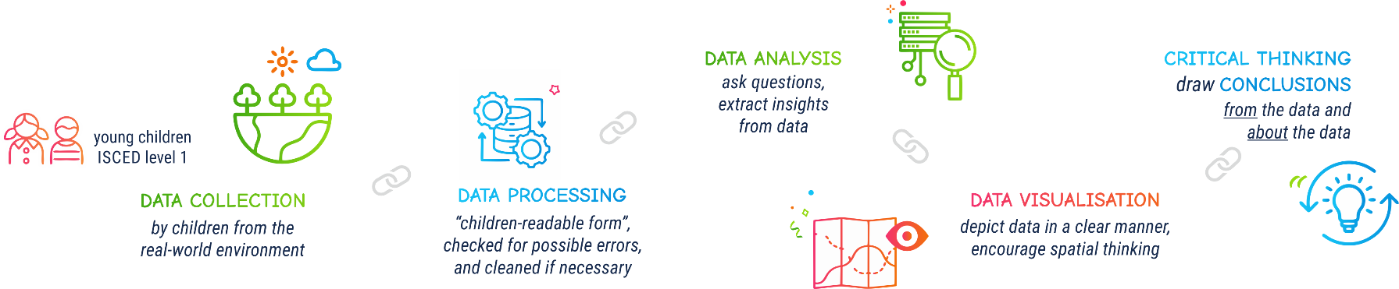

Slide 24







Contact information:
DIRECTORSproject
Assoc. Prof. Ivana Bosnić
ivana.bosnic@fer.unizg.hr
University of Zagreb
Faculty of Electrical Engineering and Computing
Assist. Prof. Ana Kuveždić Divjak
ana.kuvezdic.divjak@geof.unizg.hr
University of Zagreb
Faculty of Geodesy
Universitair Hoofddocent
Bastiaan van Loenen
B.vanLoenen@tudelft.nl
Delft University of Technology
info@kidsdirectors.eu
www.kidsdirectors.eu
Co-funded by the European Union. Views and opinions expressed are however those of the author(s) only and
do not necessarily reflect those of the European Union or the European Education and Culture Executive Agency (EACEA). Neither the European Union nor EACEA can be held responsible for them.
[Erasmus+ Project 2023-1-NL01-KA210-SCH-000157821 DIgital data-dRiven EduCaTion fOR kidS]

