Slide 1








Slide 3







WELCOME
to DIRECTORS!
Welkom!
Dobro došli!

Slide 4
Geospatial Data (and Maps) in Our Hands
🗺️🧠 ✨🔍
Escape (class)room! Spatial Data Analysis!

Slide 5
Let’s recap...
Notes:
A map is a picture or drawing of an area that shows different features such as roads, buildings, rivers, and trees. A map helps us find our way and reach specific places. It shows where things are located and how to get there.

Slide 6
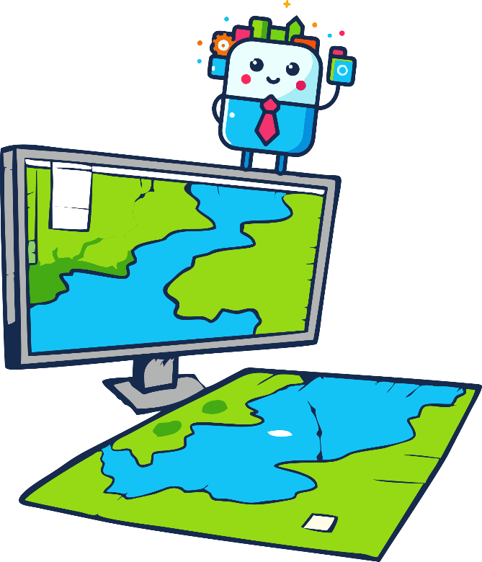
What is GIS?
GIS is like a SMART MAP on a computer..
GIS
Geo
Information
System
Smart digital maps are especially useful because they can be searched and combined with other maps and data.
Notes:
GIS (Geographic Information System) is like a super smart map. Ordinary maps, like paper ones, only show where streets, buildings, and parks are. But a GIS map can show much more! It can tell you where the nearest shop is, the shortest way to the playground, or even the best spot to play.

Slide 7
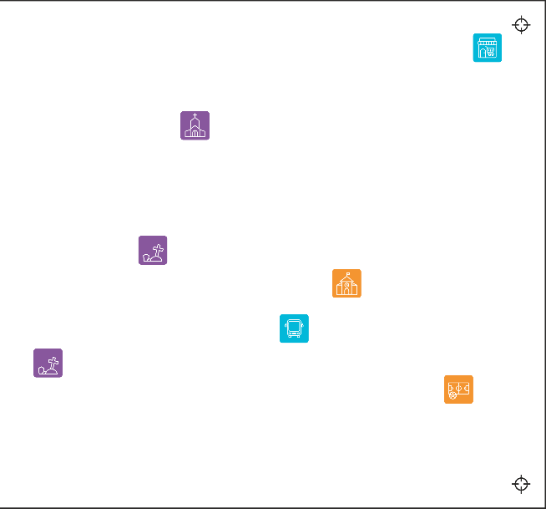
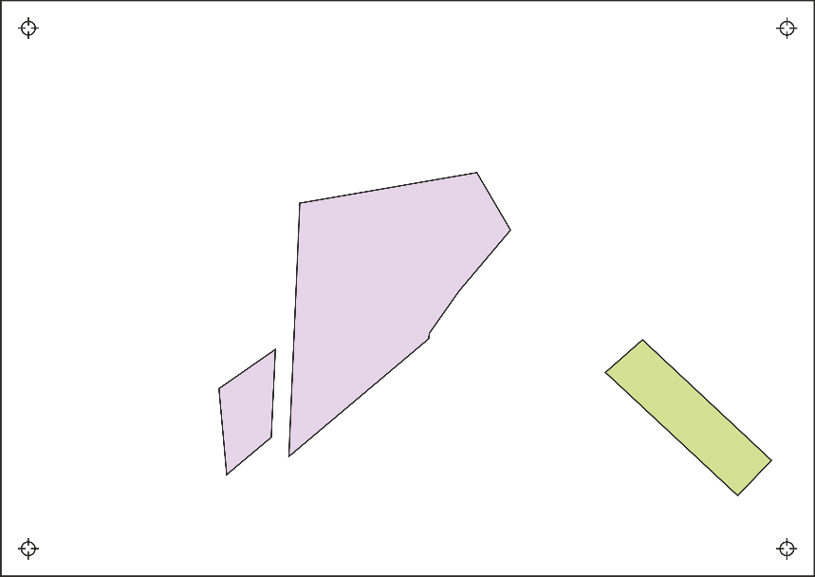
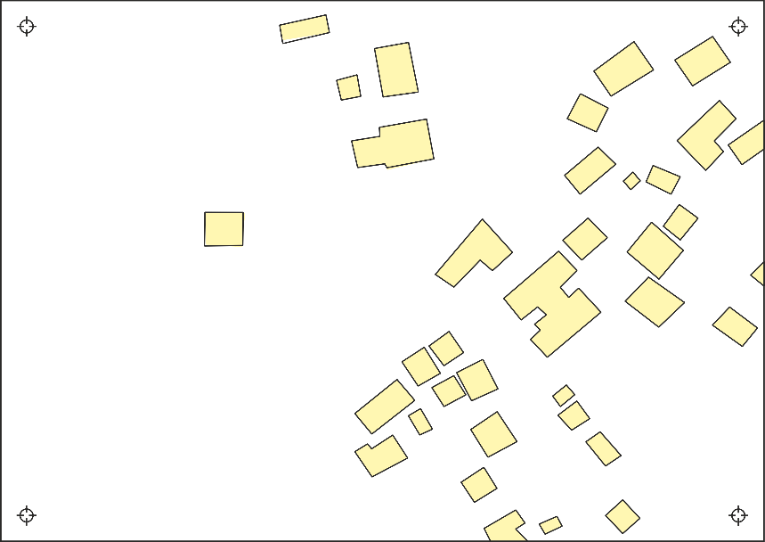
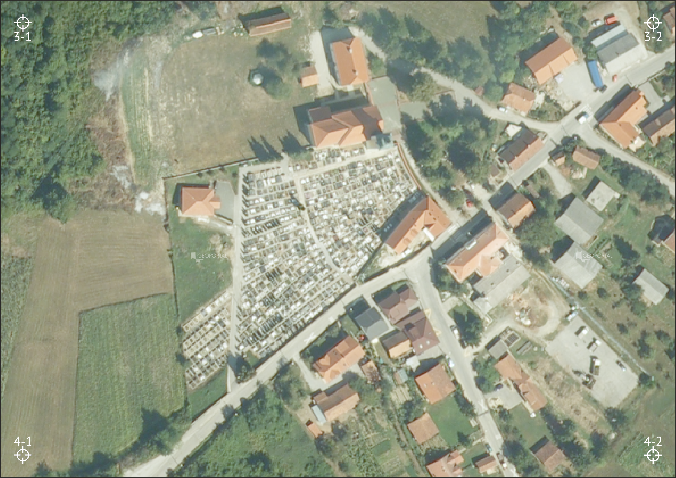
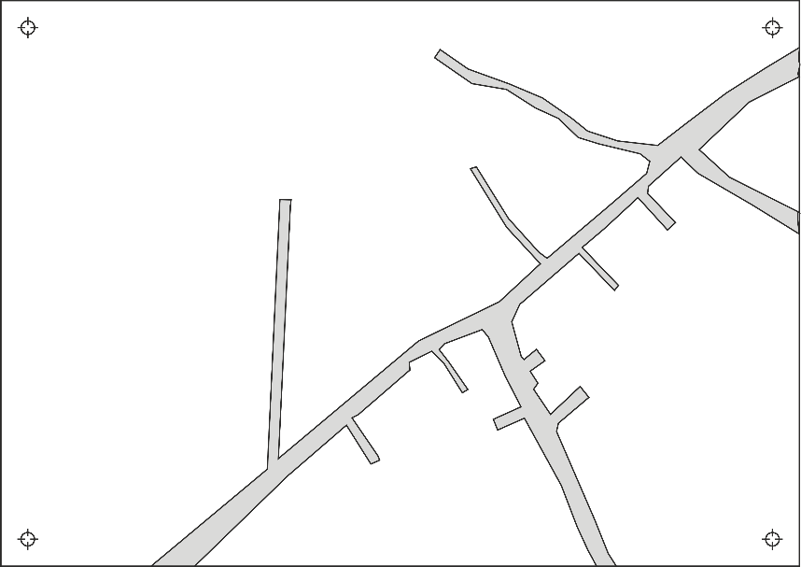
How does GIS work?
GIS
Geo
Information
System
Notes:
How does it work? GIS takes many different types of information and puts them together. Each piece of information is like a layer – one layer shows roads, another shows houses, and another shows trees. All these layers can be placed on a map, and together they help the GIS map answer questions like: “Where is the nearest park?” or “What’s the fastest way to school?”
That’s what makes GIS special – it doesn’t just show where things are, but also helps us understand why they are there and how they are connected.

Slide 8
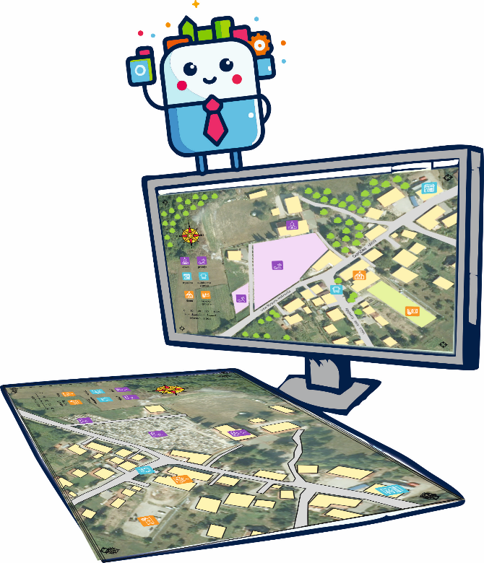
Kako radi GIS?
GIS
Geo
Informacijski Sustav
Notes:
GIS je poput super pametne karte. Pametne računalne karte su posebno korisne jer se mogu pretraživati i kombinirati s drugim kartama i podacima

Slide 9
Let’s recap...

Slide 10
We’ve made a SMART map!

Slide 11
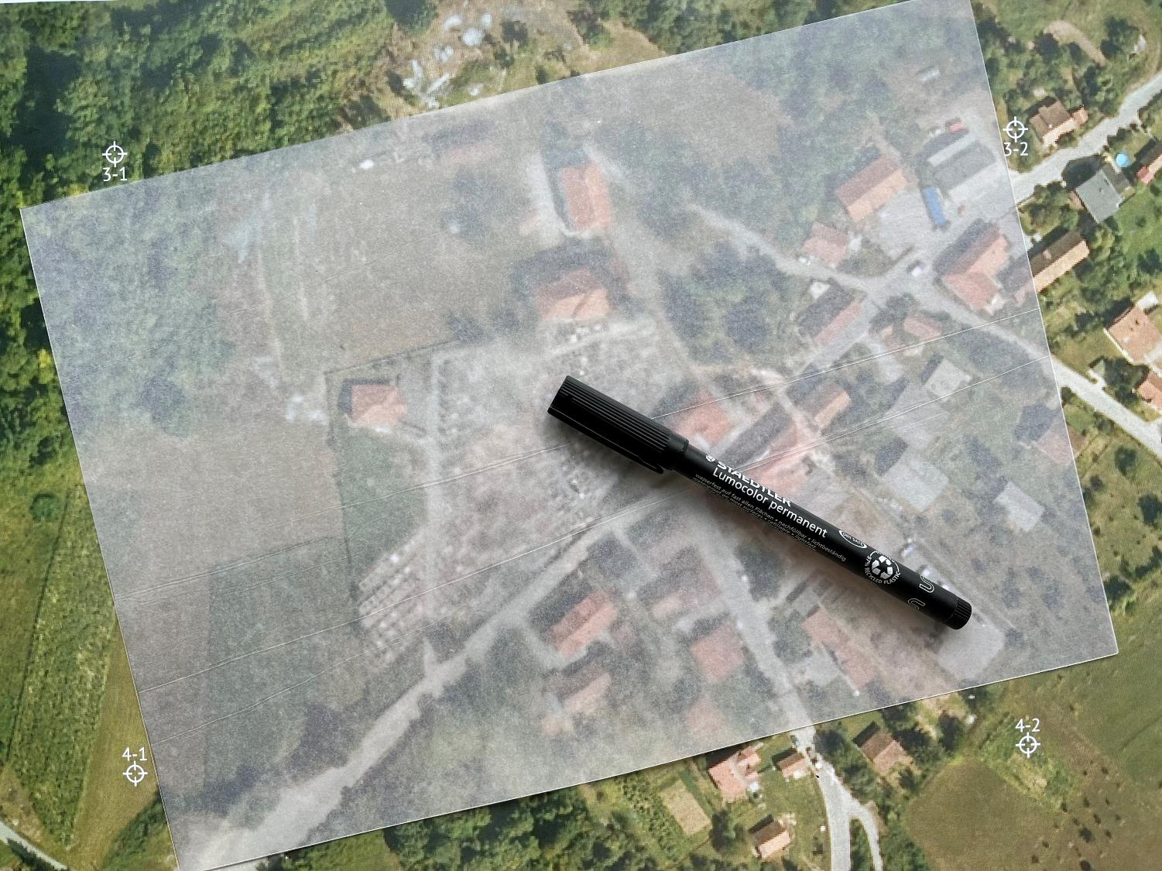

Slide 12
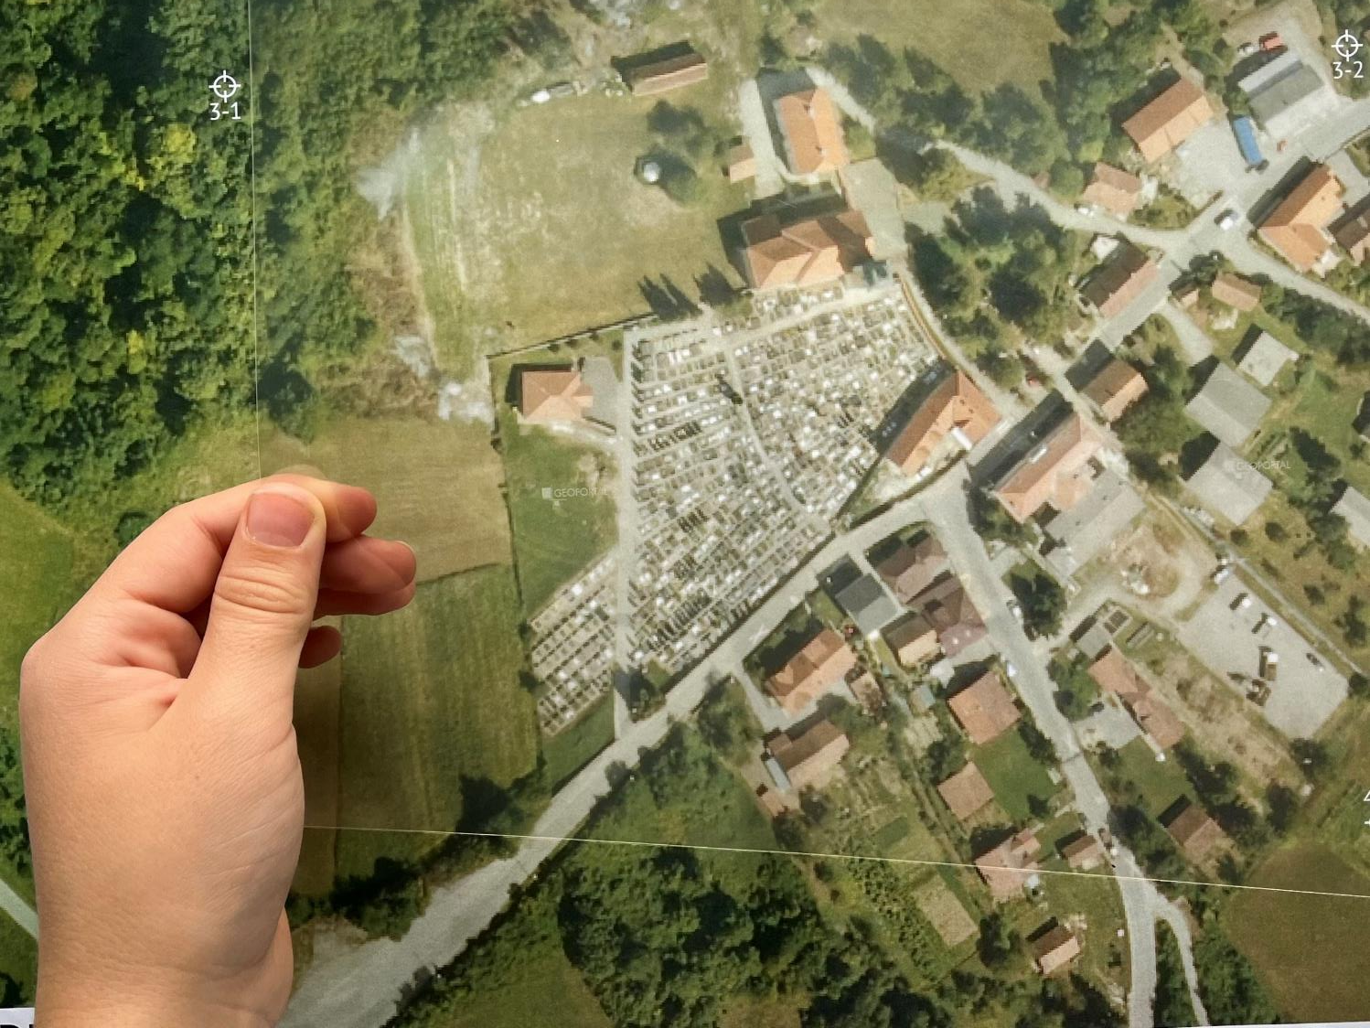

Slide 13
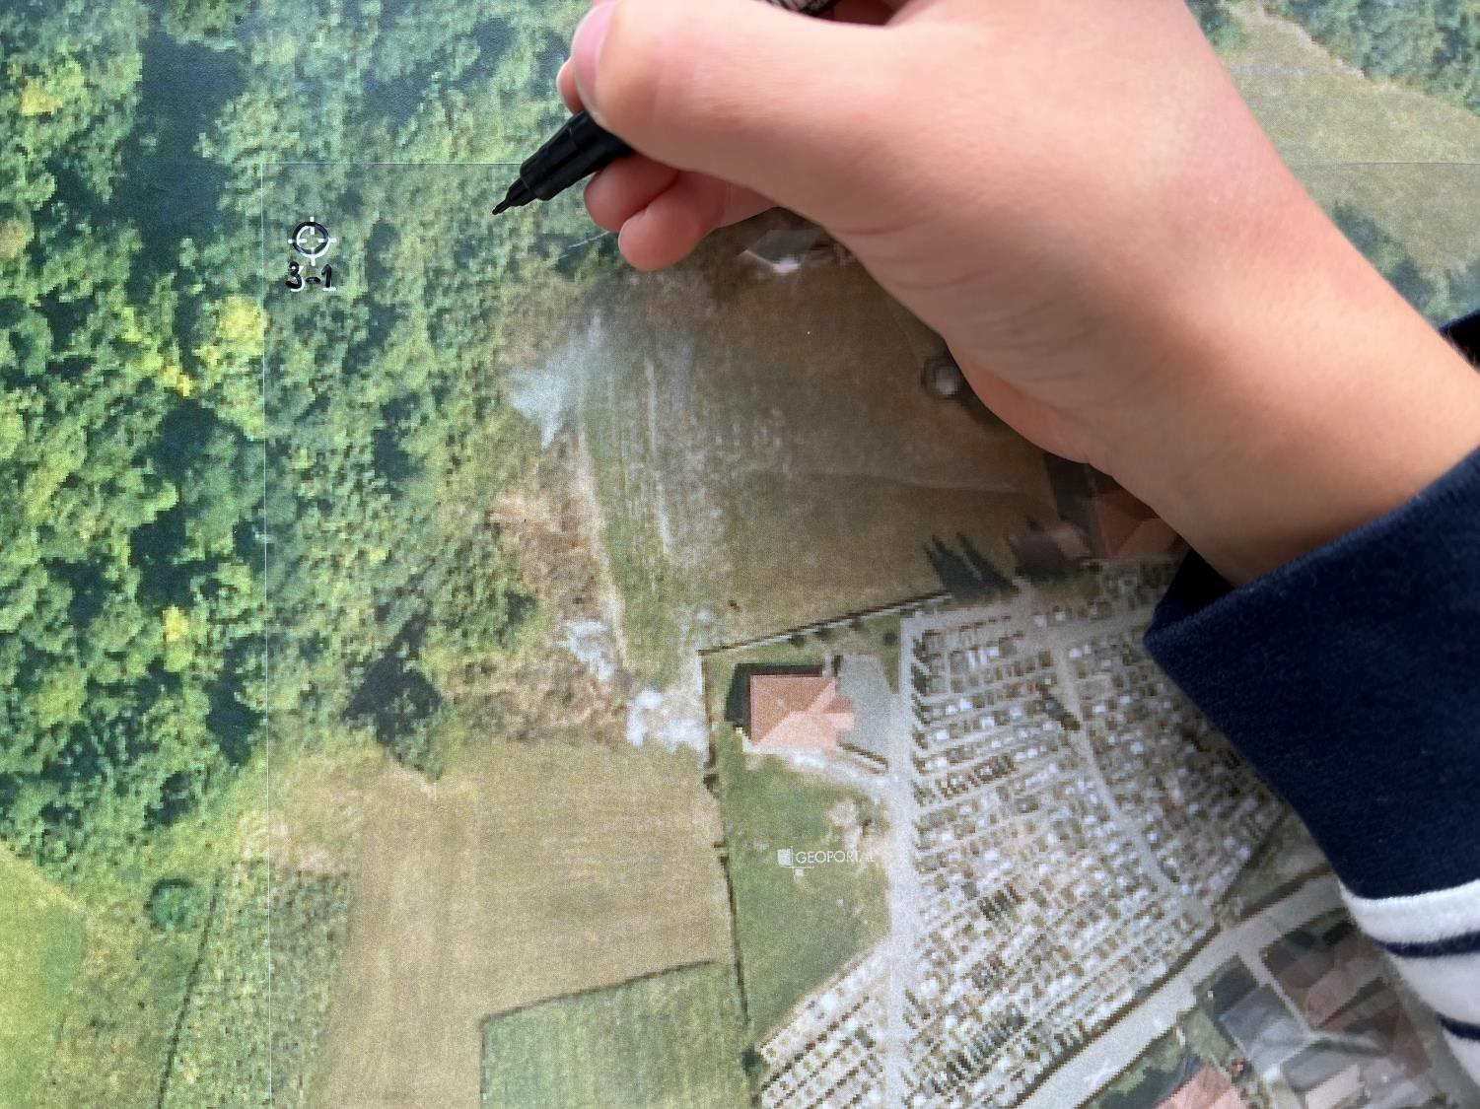

Slide 14
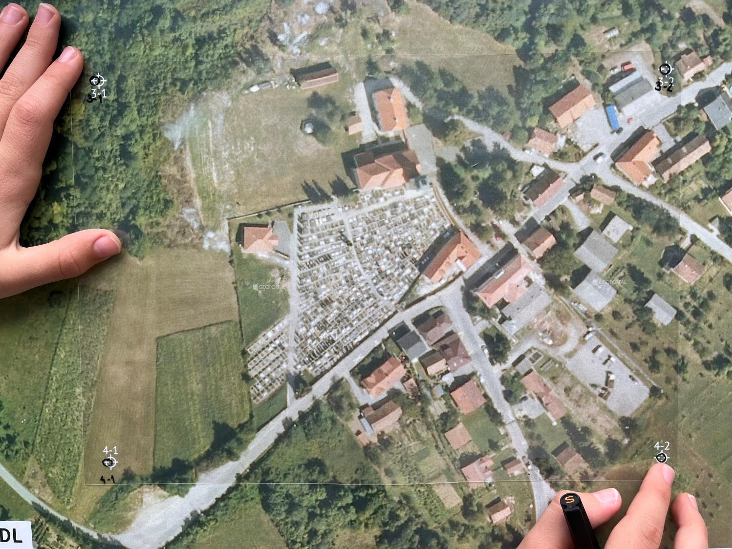

Slide 15
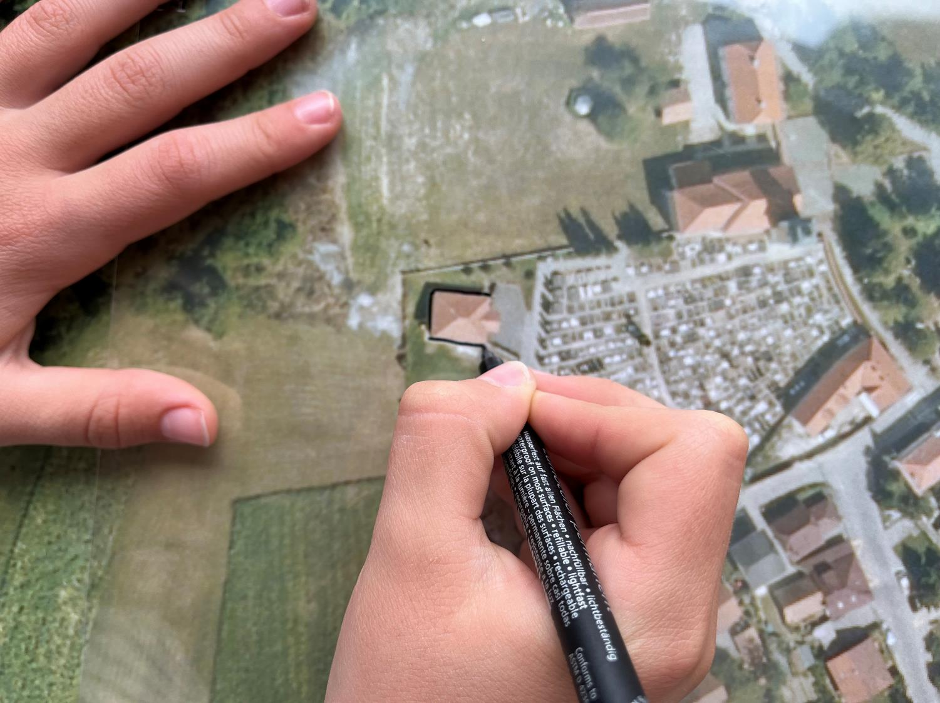

Slide 16
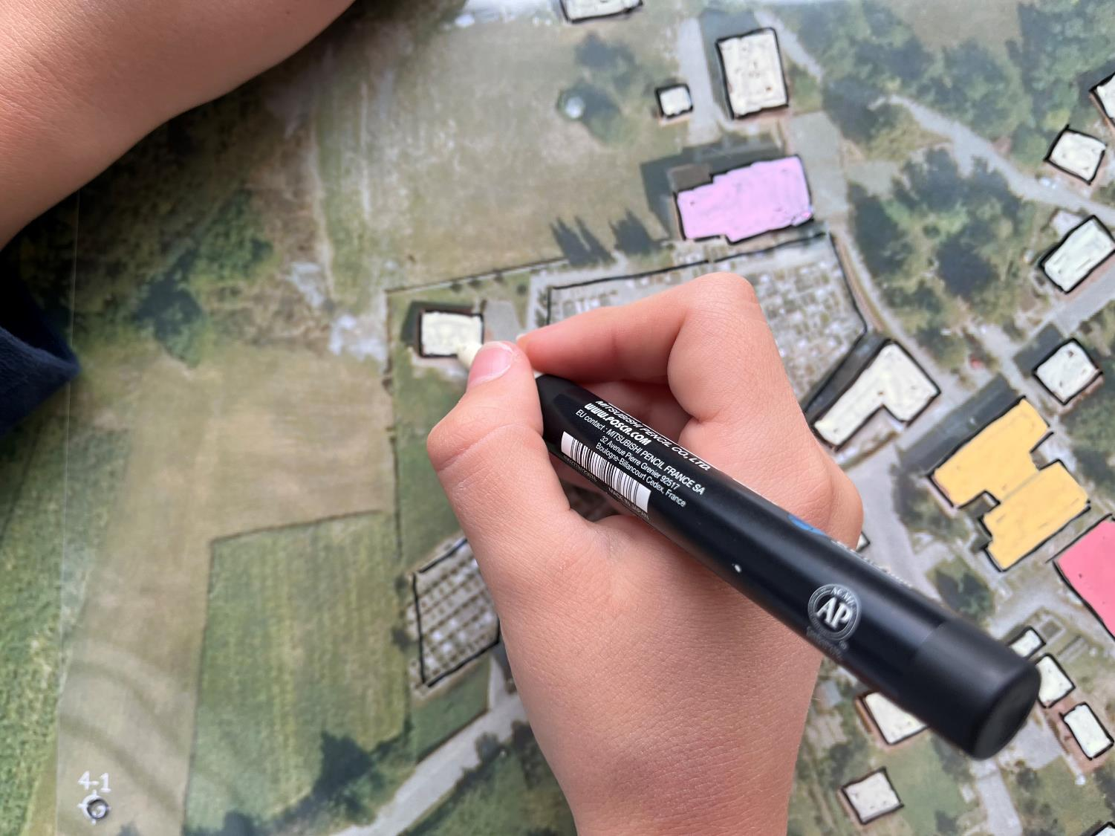

Slide 17
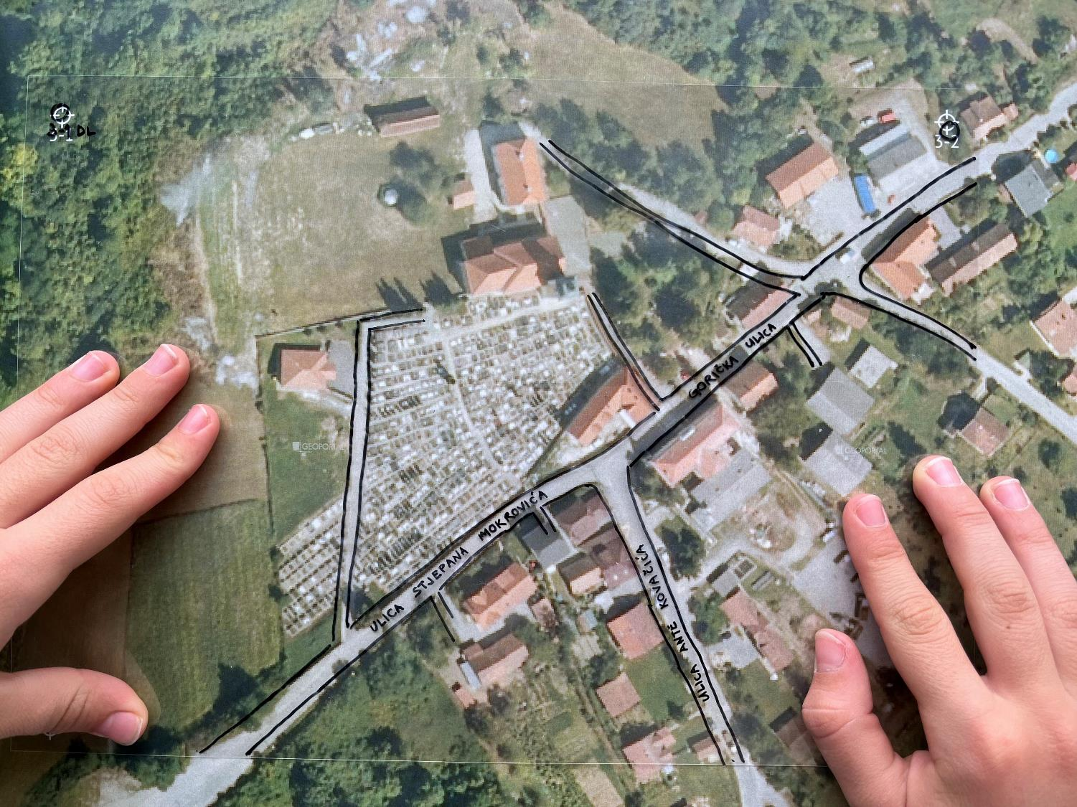

Slide 18
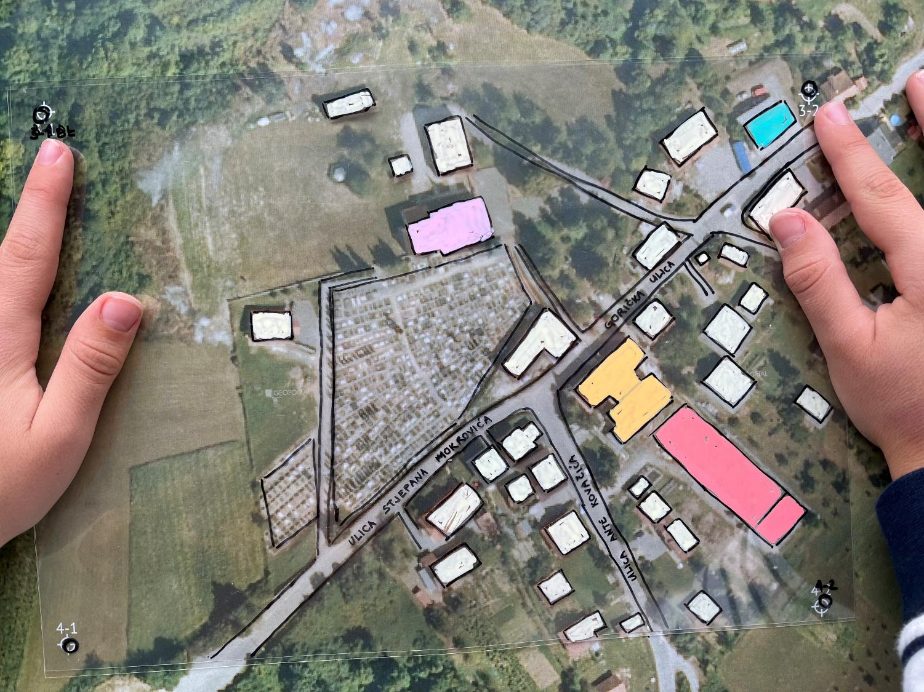

Slide 19
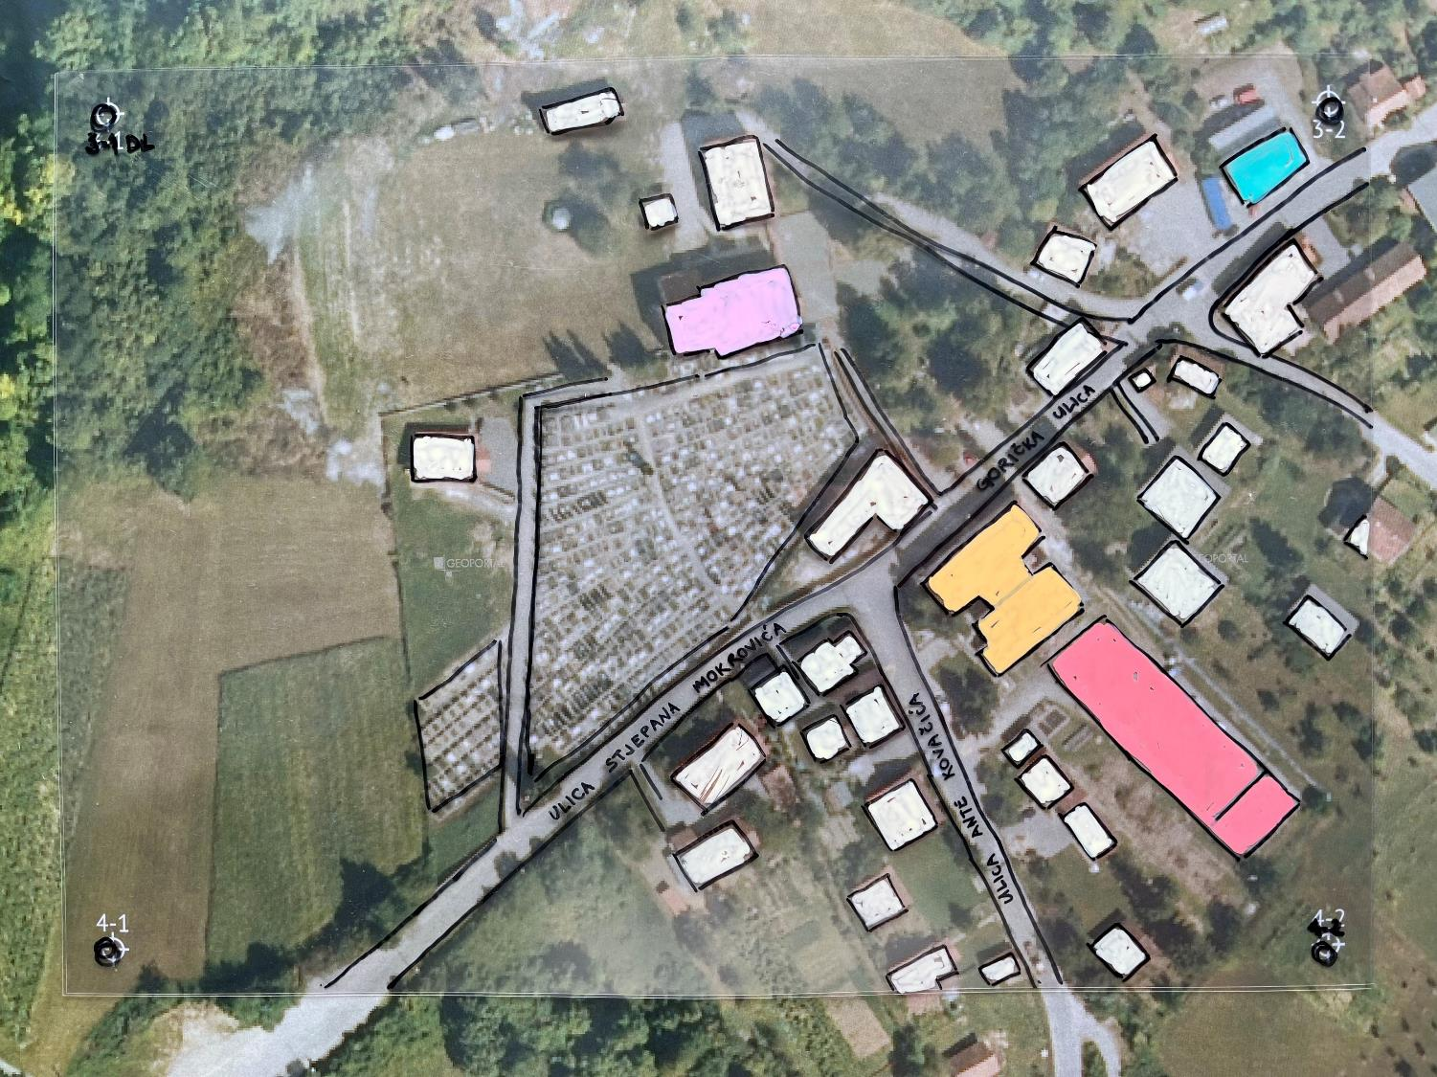

Slide 20
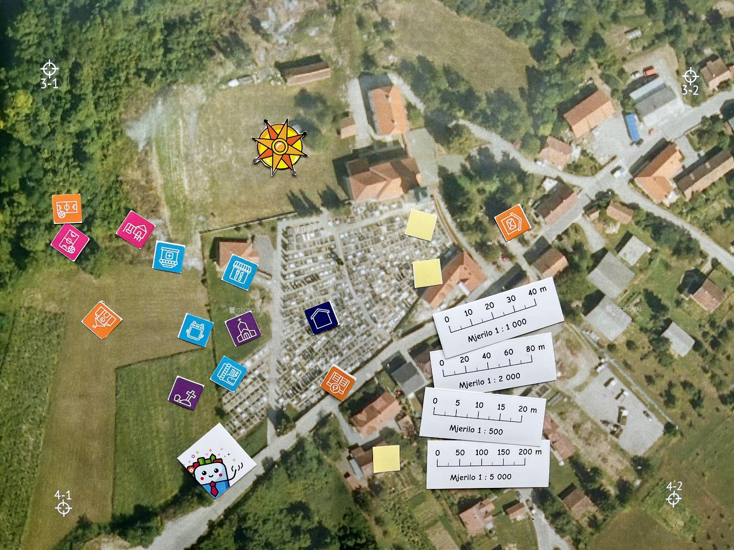

Slide 21
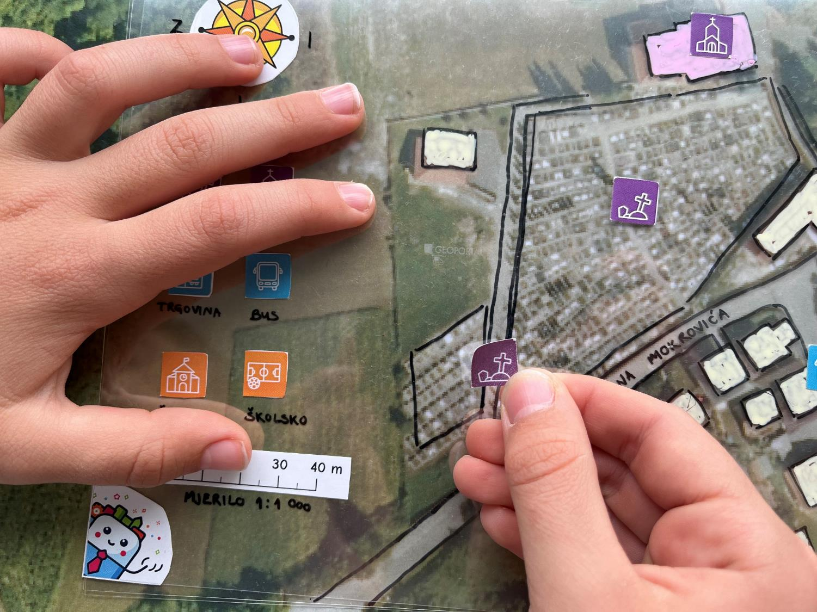

Slide 22
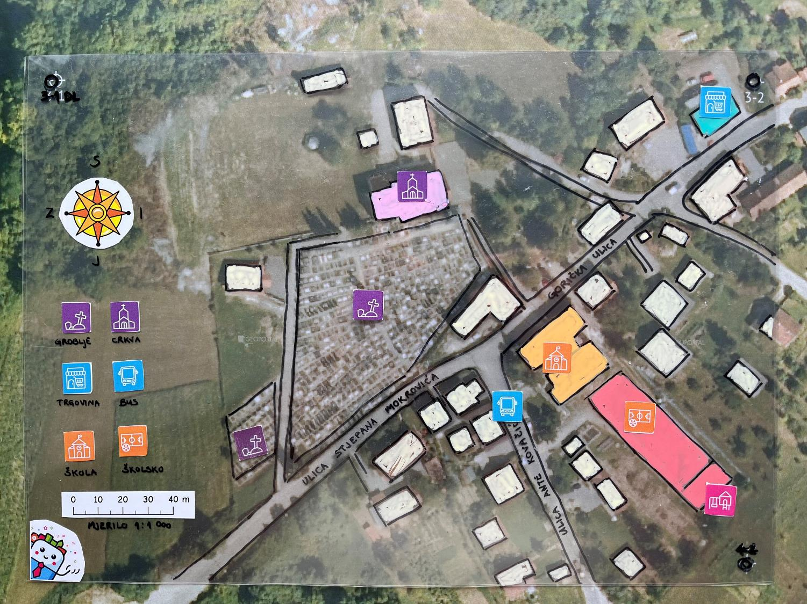

Slide 23
Escape
(class)room
The search for the missing principal?👀

Slide 24
Dear pupils, today you’re stepping into the role of detectives! 🕵️‍♀️
The principal has mysteriously disappeared, and we need your help to find him. We’ll use a smart map 🗺️ and follow the clues to discover his last known location.
Show off your detective skills 🔍, analyse the map data, and help us solve this big mystery!
The first clue is already waiting for you… are you ready for the challenge? 💡

Slide 25

Notes:
The map is locked. Solve the puzzles! The correct answers form the code to unlock the map.

Slide 26
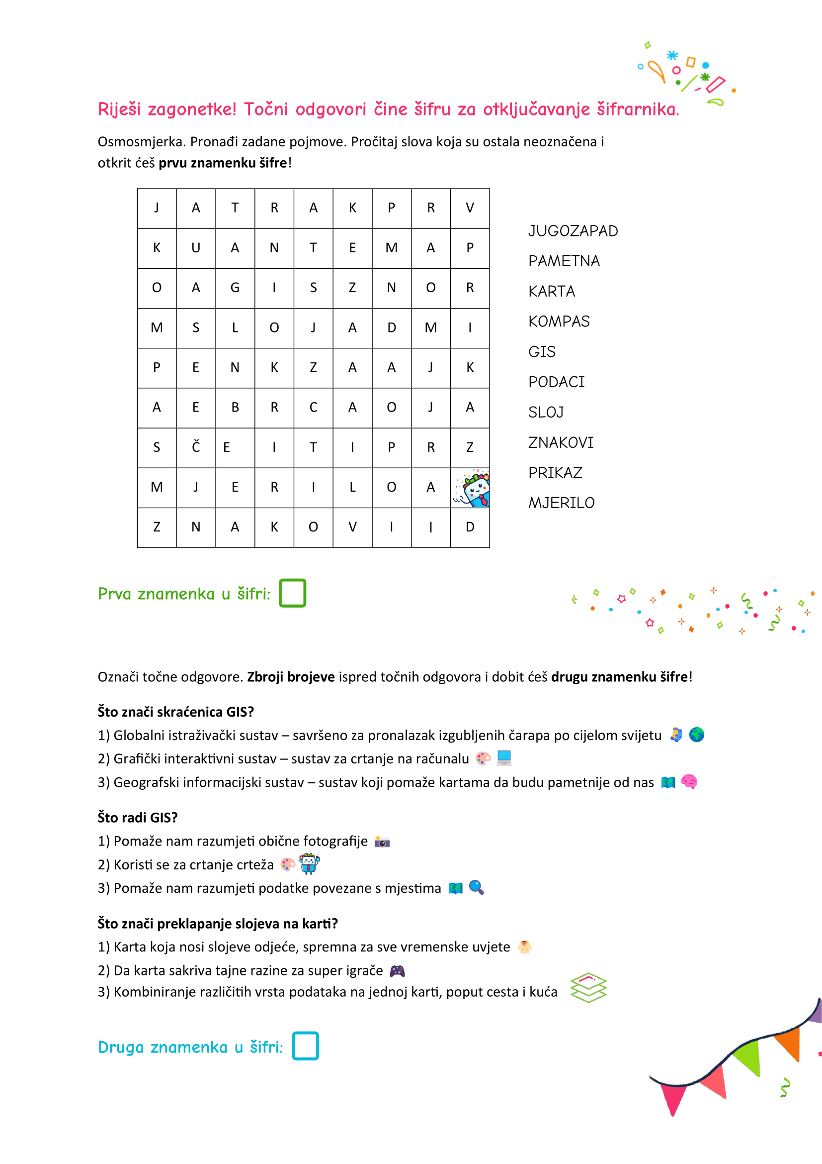
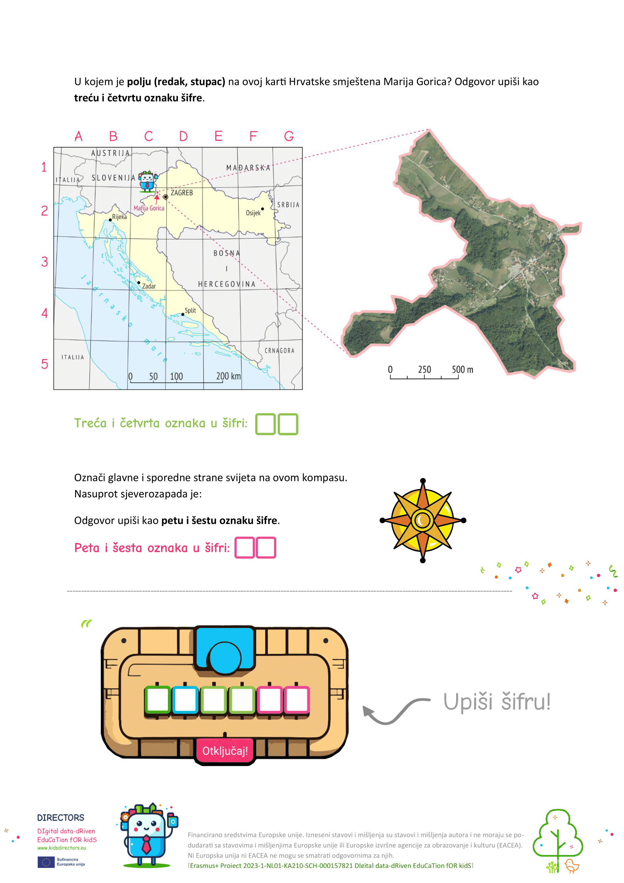

Slide 27
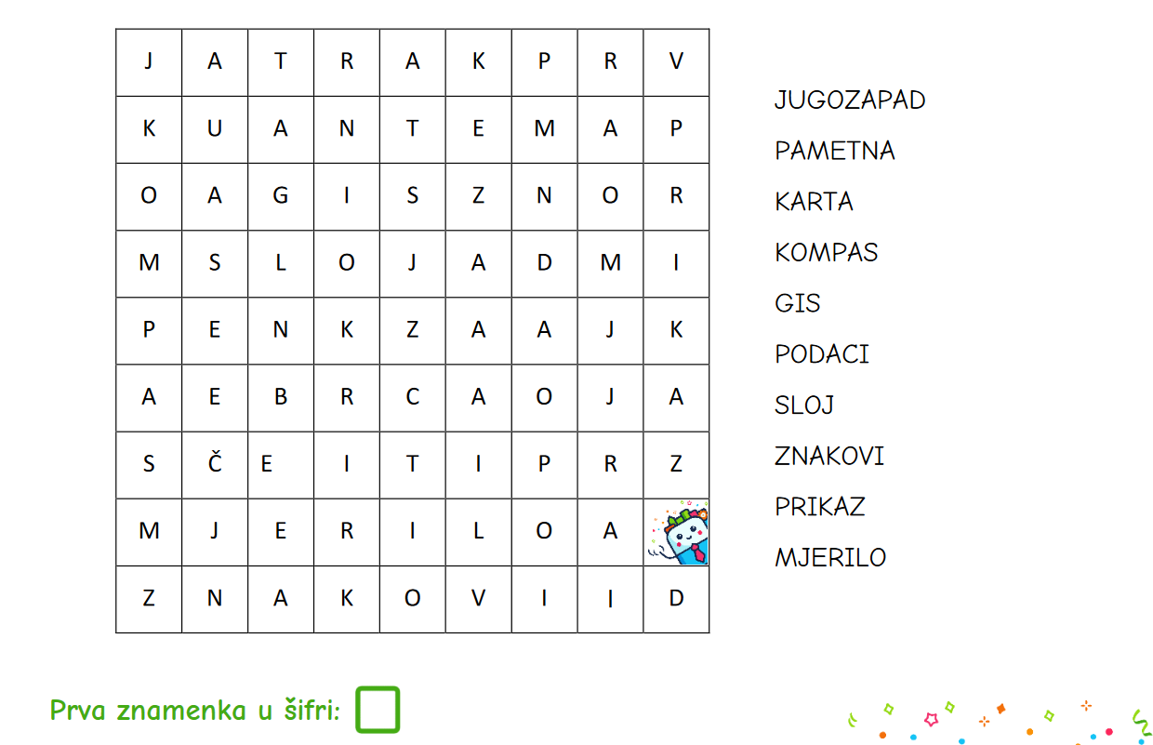
4

Slide 28
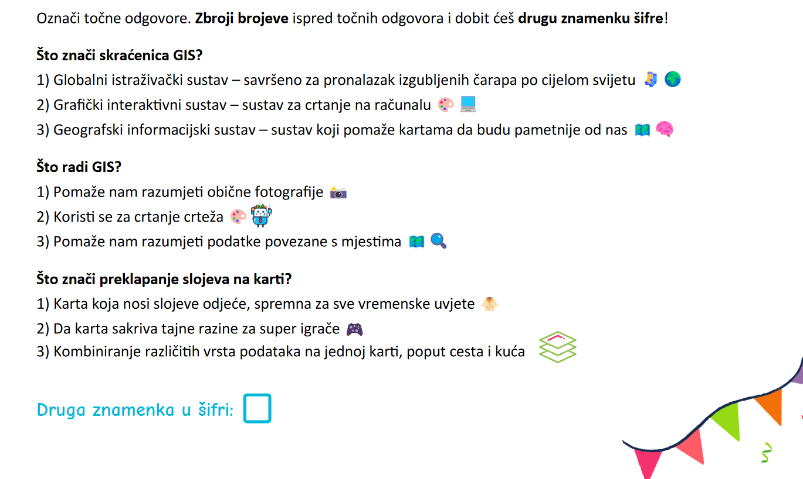
9

Slide 29
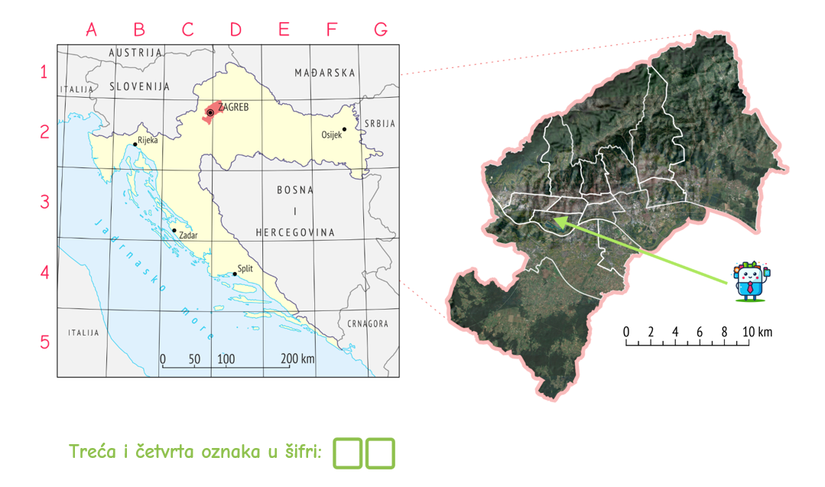
2
C

Slide 30
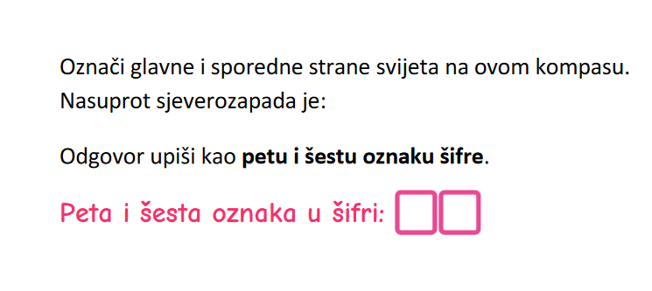


SZ
J
I
JI

Slide 31
4
9
2
C
J
I
Otključaj!

Slide 32
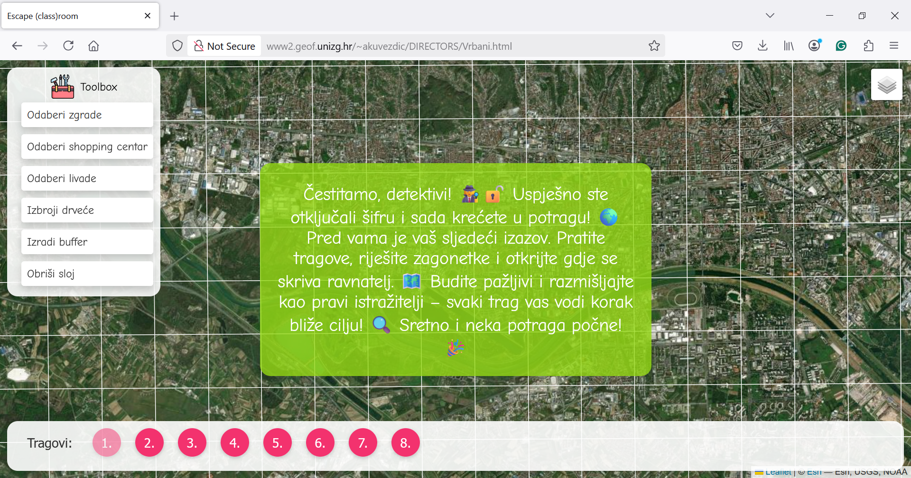

Slide 33
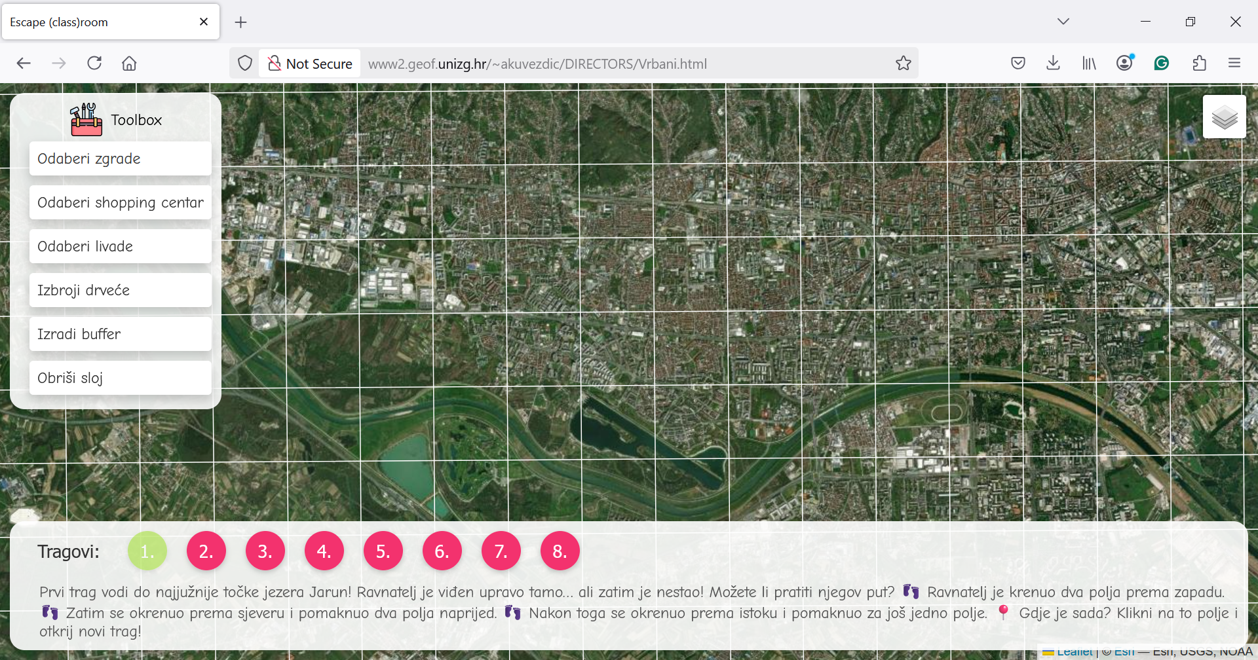

Slide 34
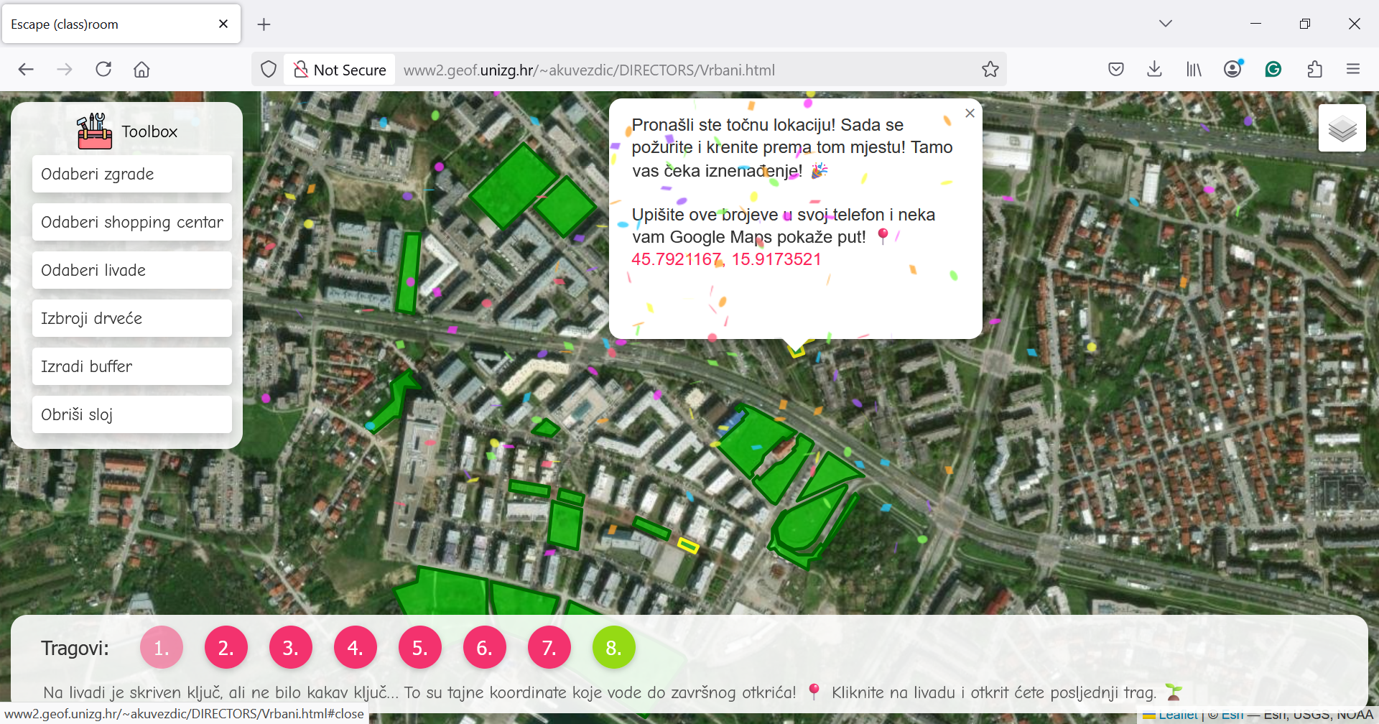

Slide 35
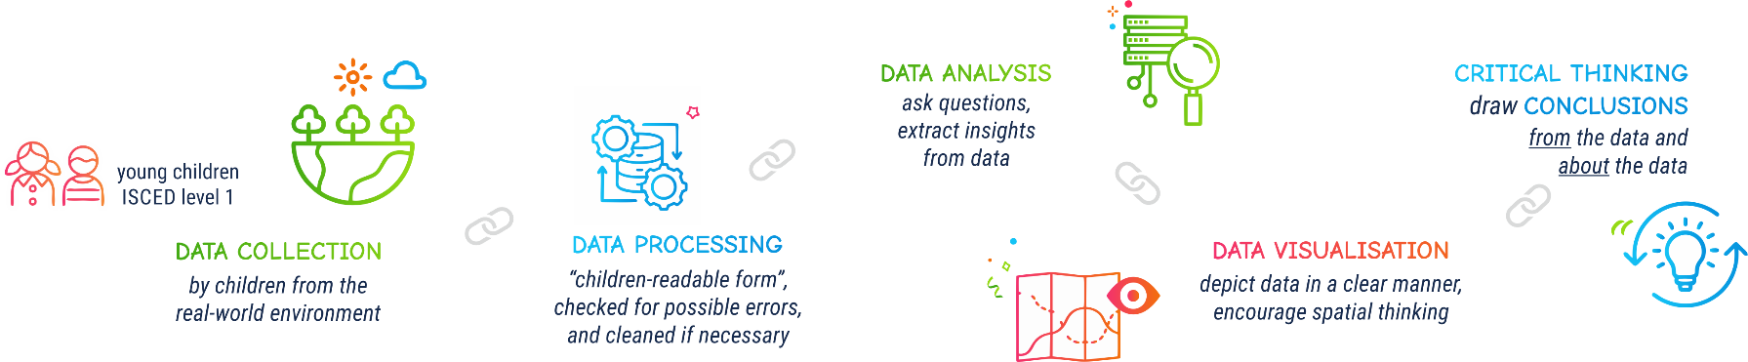

Slide 36







Contact information:
DIRECTORSproject
Assoc. Prof. Ivana Bosnić
ivana.bosnic@fer.unizg.hr
University of Zagreb Faculty of Electrical Engineering and Computing
Assist. Prof. Ana Kuveždić Divjak
ana.kuvezdic.divjak@geof.unizg.hr
University of Zagreb Faculty of Geodesy
Universitair Hoofddocent
Bastiaan van Loenen
B.vanLoenen@tudelft.nl
Delft University of Technology
info@kidsdirectors.eu
www.kidsdirectors.eu
Co-funded by the European Union. Views and opinions expressed are however those of the author(s) only and do not necessarily reflect those of the European Union or the European Education and Culture Executive Agency (EACEA). Neither the European Union nor EACEA can be held responsible for them. [Erasmus+ Project 2023-1-NL01-KA210-SCH-000157821 DIgital data-dRiven EduCaTion fOR kidS]

